Slide 1
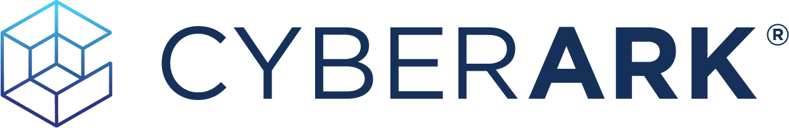
The Identity Security
Company
cyberark.is/identity-security

Slide 2
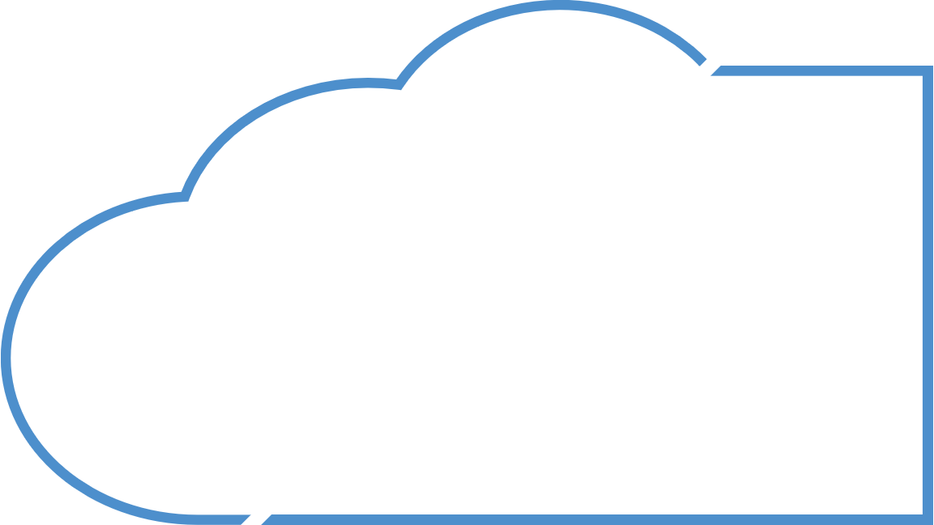
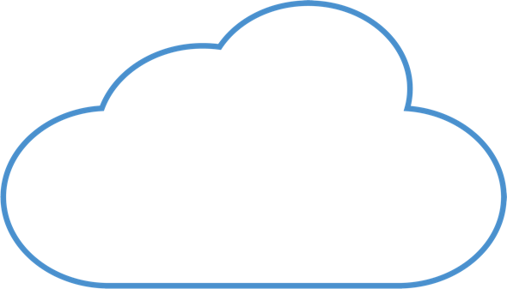
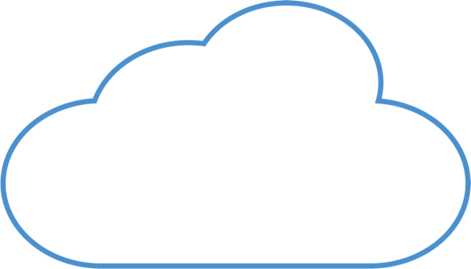

















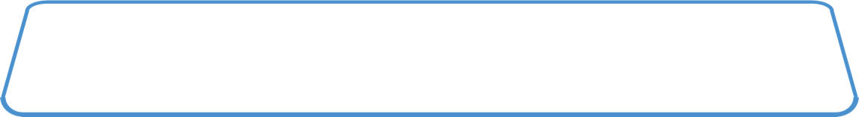


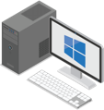




Privilege is Everywhere
All Identities CAN be Privileged Under Certain Conditions
Hybrid Cloud
SaaS
SaaS
IaaS / PaaS
*nix Server
IoT
IT Ops Tools
App Server
Database
Network Devices
Cloud Native
Apps
Containers
VM’s &
Storage
Serverless
Code
Code
Code
Admin
DevOps
Apps / Robots
3rd Party Vendors
Workforce
IDENTITIES
Office
WFH
Temporary Location
Mac
PC
Mobile
workplaces
Workspaces
Notes:
Let’s talk for a moment, about the expansion of Identities.
In the past, typically IT Admins were considered the only privileged users, but in today’s environment almost any Identity can be privileged under certain conditions.
This can be a developer or DevOps engineer who have access to source code or a DevOps pipeline and tools that can easily impact the organizations production environment and therefore represent high risk.
It can be an application or RPA that needs powerful privileges in order to access corporate resources to perform its tasks
It can be a 3rd party vendor that needs to access corporate resources remotely.
Lastly, it can also be a workforce team member that accesses a financial system with powerful privileges based on their role and responsibility.
All these types of identities represent high risk to the organization and therefore require high level of security controls.

Slide 3

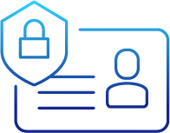

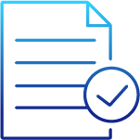








Identity Security Defined
Identities
Targets
Applications
Access & Authentication
Privileged Controls
Entitlements
Human
Centralized Access
(Single Sign-On)
Adaptive MFA and
Passwordless
Endpoint Identity
Security
Credentials and Secrets Management
Session Management
for Federated and
Shared Accounts
Standing and
Just-in-Time Access
Identity / Lifecycle
Management
Permissions and Entitlements Management
Infrastructure
Data
Environments
Machine
Conduct Continuous AI-based Threat and Risk Assessment
Cloud
Hybrid
Enforce Least Privilege
Notes:
CyberArk Identity Security is where privileged controls meet access and entitlement capabilities to modernize IT, secure applications, cloud workloads, and reduce risk on endpoints. Adaptive multi-factor authentication, combined with federated, just-in-time access, least privilege enforcement and continuous threat analytics deliver unparalleled security controls to combat today’s and tomorrow’s sophisticated attacks without sacrificing the speed of business.

Slide 4
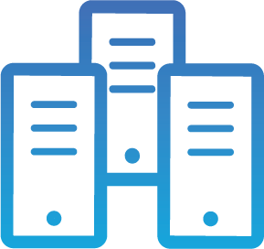
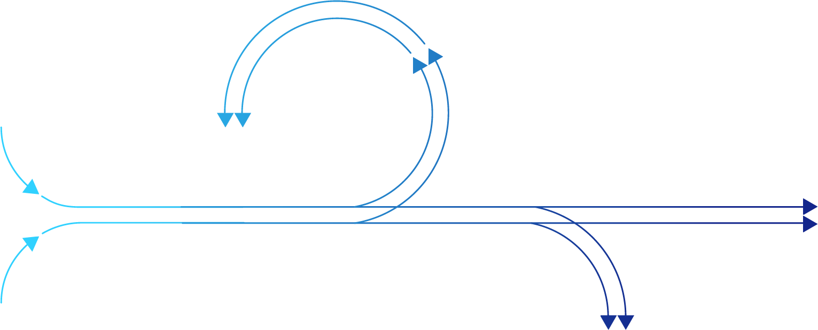



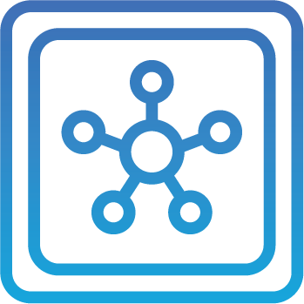

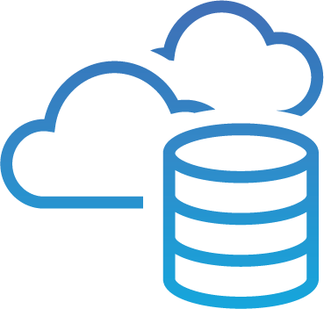

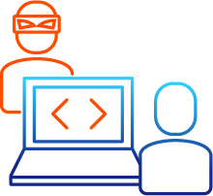
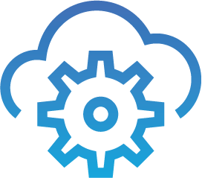
Your Environment Evolves, Attack Paths Don’t
Data Centers
Internal Threats
Move Laterally
Perform
Reconnaissance
OT
Escalate
Privileges
Escalate
Privileges
Exfiltrate Data
Disrupt Business
External Threats
Hybrid & Multi-Cloud
SaaS
Notes:
Increasingly organizations are adopting multi- and hybrid-cloud to improve operational efficiencies and time to market. The pandemic has ensured that hybrid and remote workforce is the norm globally. With these changes, the number and breadth of cyberattacks has grown exponentially. Senior leadership and executives now need to balance driving innovation and business goals in a dynamic environment with protecting their organizations from the risk of attacks and potential damage from the aftermath of a breach that potentially takes advantage of security gaps in those quickly evolving environments.
It's not all bad news though, the attack paths have stayed relatively consistent despite the evolution.
For example, attackers usually target tier 2 assets used by employees or vendors-- the endpoints. Once they land, they then harvest human or non human credentials to move laterally and vertically. The next step is Tier 1, often servers or VMs, commonly looking for powerful access to tier 0 assets like domain controllers and cloud consoles. More and more assets exist in Tier 0 these days and this applies to organizations at either end of the on-prem to full Cloud adoption paradigm. Once the attackers have this level of access, it's game over.
The risk from internal or external threats taking advantage of escalated privilege and the associated outcomes of compromise are not only limited to loss of revenue streams in the short term. They can result in long term brand and reputational damage with potentially catastrophic results.

Slide 5
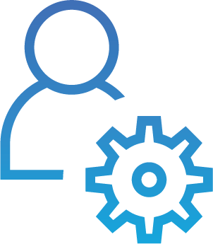
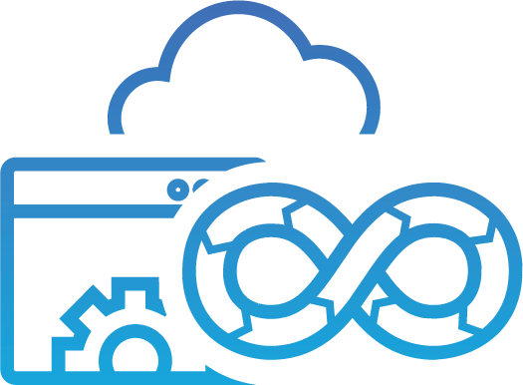
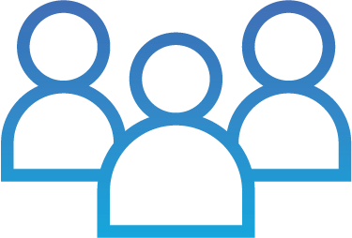
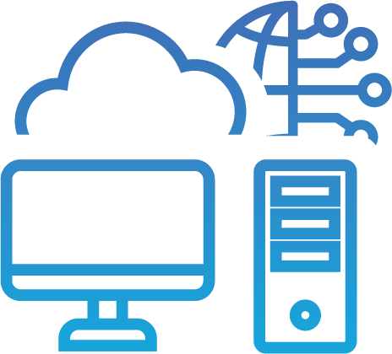
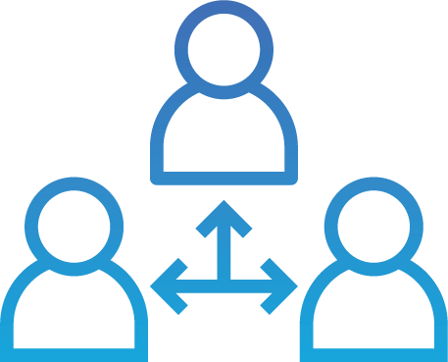
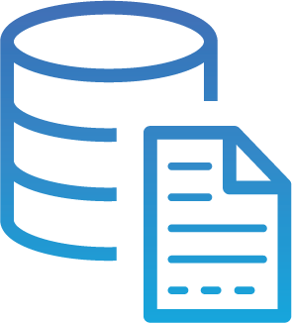
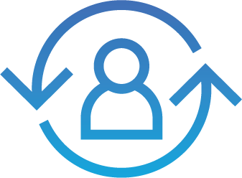
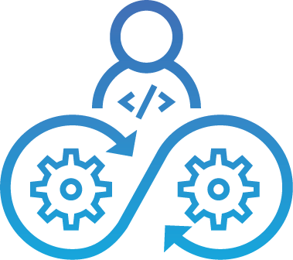
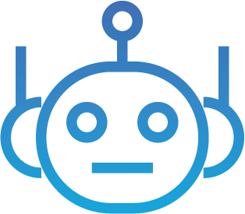
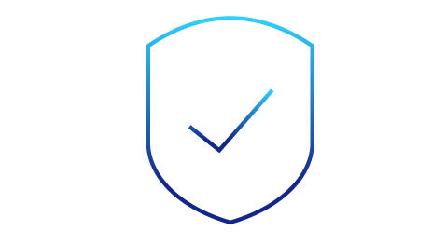
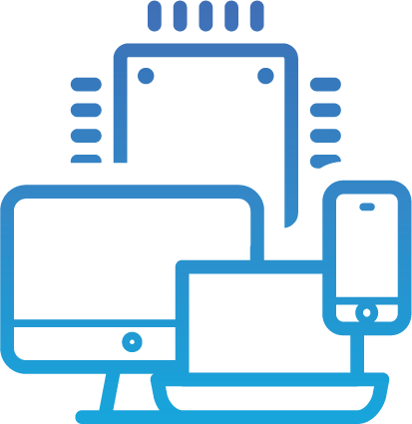
Securing Identities is Critical
For Zero Trust
Identities
Resources
Admins
Applications
& Services
Remove Implicit Trust
Workforce
Devices may not be Enterprise Owned
Resources may not be Enterprise hosted
Infrastructure &
Endpoints
Dynamically Enforce Policy, Authentication and Authorization
Third Parties
Data
Environments
Customers
Data Centers
Continuously Monitor
Principle Of Least Privilege
DevOps
OT
Workloads
Hybrid & Multi-Cloud
Devices
    Zero Trust
SaaS
Notes:
The reason we’re talking about Identity security is because, Identity security is the backbone of Zero Trust. The proliferation of privilege functions means focusing on IT privileged users is no longer enough. Access, governance, and Privileged Access Management are not siloed capabilities anymore and must work together holistically to allow seamless, secure, and automated access for all identities. This unified approach enables organizations with an Identity Security backbone for Zero Trust so they can then build on and combine with the other critical pillars of device, network, application workload and data trust.
--

Slide 6
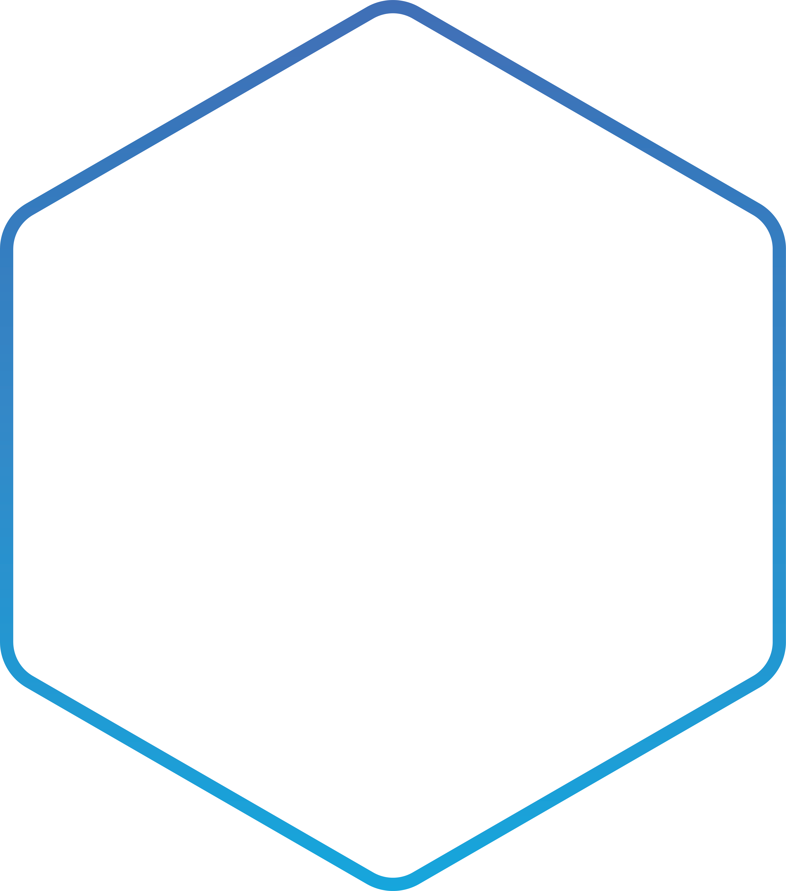
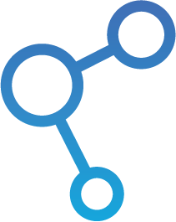
Identities
Resources
Identity Security Platform
Admins
Applications &
Services
Seamless & Secure
Access for
All Identities
Intelligent
Privilege
Controls
Flexible Identity
Automation &
Orchestration
Workforce
Infrastructure &
Endpoints
Third Parties
Workforce &
Customer
Access
Endpoint
Privilege
Security
Privileged
Access
Management
Cloud
Privilege
Security
Secrets
Management
Identity
Management
Data
Environments
Customers
Data Centers
DevOps
OT
Identity Security Intelligence
Workloads
Shared
Services
Hybrid & Multi-Cloud
Single Admin Portal | Workflows | Unified Audit | Authentication & Authorization
Devices
SaaS | Hybrid | Self-Hosted
SaaS
Notes:
Now that we have covered what identity Security is and why we need it, let’s look at how CyberArk delivers on the promise of a holistic Identity Security platform.
Every Identity in every organization requires access to resources that help them to do their job. The goal is to make sure this is done securely and efficiently. Without security, we leave holes open for attackers. Without efficiency, productivity is left behind. The balance is the ultimate goal. Let’s highlight a day in the life of a user. This can be any user that needs access to applications or servers and show how CyberArk’s Identity Security Platform makes access to everything secure.

Slide 7

Identities
Resources
Identity Security Platform
Admins
Applications &
Services
Seamless & Secure
Access for
All Identities
Intelligent
Privilege
Controls
Flexible Identity
Automation &
Orchestration
Workforce
Infrastructure &
Endpoints
Third Parties
Workforce &
Customer
Access
Endpoint
Privilege
Security
Privileged
Access
Management
Cloud
Privilege
Security
Secrets
Management
Identity
Management
Data
Environments
Customers
Data Centers
DevOps
OT
Identity Security Intelligence
Workloads
Shared
Services
Hybrid & Multi-Cloud
Single Admin Portal | Workflows | Unified Audit | Authentication & Authorization
Devices
SaaS | Hybrid | Self-Hosted
SaaS
Notes:
While there are all types of personas with different levels of access at your organization, let’s start with Bob, a developer.
[CLICK]
Bob needs to access different types of resources within the environment, whether that's applications, services or infrastructure.
[NEXT SLIDE]

Slide 8
Identities
Resources
Identity Security Platform
IT Admin
Applications &
Services
Seamless & Secure
Access for
All Identities
Intelligent
Privilege
Controls
Flexible Identity
Automation &
Orchestration
Workforce
Infrastructure &
Endpoints
Third Parties
Workforce &
Customer
Access
Endpoint
Privilege
Security
Privileged
Access
Management
Secrets
Management
Cloud
Privilege
Security
Identity
Management
Data
Environments
Customers
Data Centers
Adaptive Multifactor Authentication
Single Sign-On
Directory Services
DevOps
OT
Identity Security Intelligence
Workloads
Shared
Services
Hybrid & Multi-Cloud
Single Admin Portal | Workflows | Unified Audit | Authentication & Authorization
Devices
SaaS | Hybrid | Self-Hosted
SaaS
Notes:
First, we need to make sure that Bob is who he says he is. We're going to do that by utilizing the identity management and access management capabilities of the CyberArk platform.
When Bob connects to the environment, we provide Adaptive multi-factor authentication. This could be a prompt on phone, a call to phone or it could be utilizing a fingerprint reader on his laptop.
This all depends on what the administrators decide for that specific application, and it is dependent on certain conditions. For example, whether access is coming from a specific IP address or a specific time of day, etc. This adaptive strong authentication is the key to reducing authentication fatigue– leveraging internal and external signals of trust to heighten or relax authentication means that Bob won’t be forced to continuously reauthenticate if unless his access is unusual or it’s desired based on the application.
We also want to provide Single Sign-On to make sure that Bob can gain access to those applications without jumping through a lot of hoops. This drives business efficiencies and ensures Bob is effective every single day.
[NEXT SLIDE]

Slide 9
Identities
Resources
Identity Security Platform
IT Admin
Applications &
Services
Seamless & Secure
Access for
All Identities
Intelligent
Privileged
Controls
Flexible Identity
Automation &
Orchestration
Workforce
Infrastructure &
Endpoints
Third Parties
Workforce &
Customer
Access
Endpoint
Privilege
Security
Privileged
Access
Management
Secrets
Management
Cloud
Privilege
Security
Identity
Management
Data
Environments
Customers
Data Centers
Ransomware Protection
Least Privilege
Credential Theft Protection
DevOps
OT
Identity Security Intelligence
Workloads
Shared
Services
Hybrid & Multi-Cloud
Single Admin Portal | Workflows | Unified Audit | Authentication & Authorization
Devices
SaaS | Hybrid | Self-Hosted
SaaS
Notes:
Once Bob identifies himself, he will likely need to run some tasks or use some applications locally right on his laptop… and chances are some of those apps require admin rights Naturally, full admin access on a workstation creates a significant amount of risk. Our goal should be to make sure that Bob can do what he needs to do, without needing full administrative rights on this workstation. By allowing him to elevate only certain tasks, we can remove his full admin rights.
While admin rights can get you a long way in the attack chain, these days more and more attacks are being executed in the standard user context… so we also want to protect against ransomware and malware, as well as credential theft attacks, that may leverage different types of applications and their credential stores to gain access to credentials stored on those workstations that potentially could give attackers lateral movement across the board.
[NEXT SLIDE]

Slide 10
Identities
Resources
Identity Security Platform
IT Admin
Applications &
Services
Seamless & Secure
Access for
All Identities
Intelligent
Privilege
Controls
Flexible Identity
Automation &
Orchestration
Workforce
Infrastructure &
Endpoints
Third Parties
Workforce &
Customer
Access
Endpoint
Privilege
Security
Privileged
Access
Management
Secrets
Management
Cloud
Privilege
Security
Identity
Management
Data
Environments
Customers
Data Centers
Elevated Access
Session Isolation and Monitoring
Emergency Access
DevOps
OT
Identity Security Intelligence
Workloads
Shared
Services
Hybrid & Multi-Cloud
Single Admin Portal | Workflows | Unified Audit | Authentication & Authorization
Devices
SaaS | Hybrid | Self-Hosted
SaaS
Notes:
We also must make sure that Bob can get to the different endpoints and servers that he may need powerful access to. And this is where elevated access comes into play.
This is where Bob needs elevated access to a server, database, or console. This is where Bob would leverage Privilege Access Management.
The powerful secrets that Bob needs for access are vaulted and being rotated automatically after each use or on a schedule.
Next, we want to make sure this is easy for Bob by allowing Bob to connect using his own native clients with the power of session isolation and monitoring. This assure we won’t slow Bob down. Likewise, if this is true emergency access, we want to create workflows for Bob to get the approval he needs to use these secrets without having to completely reinvent the way he worked before PAM.
[NEXT SLIDE]

Slide 11
Identities
Resources
Identity Security Platform
IT Admin
Applications &
Services
Seamless & Secure
Access for
All Identities
Intelligent
Privilege
Controls
Flexible Identity
Automation &
Orchestration
Workforce
Infrastructure &
Endpoints
Third Parties
Workforce &
Customer
Access
Endpoint
Privilege
Security
Privileged
Access
Management
Secrets
Management
Cloud
Privilege
Security
Identity
Management
Data
Environments
Customers
Vendor
Privileged
Access
Management
VPN-Less
Passwordless
Just In Time
Data Centers
DevOps
OT
Identity Security Intelligence
Workloads
Shared
Services
Hybrid & Multi-Cloud
Single Admin Portal | Workflows | Unified Audit | Authentication & Authorization
Devices
SaaS | Hybrid | Self-Hosted
SaaS
Notes:
While Bob can get a lot done, there may be times that he needs to rely on third party vendors– even giving them access to critical systems like Windows Servers, Databases or possibly Web Applications. This is when we would introduce Vendor Privileged Access Management solution that can put those vendors in the right place just in time with just the right number of permissions.
Now of course, this can eliminate the need for those Vendors to own passwords, require VPNs and even external MFA devices.
An all-in-one solution getting vendors to where they need to be now. This could also be to web hosted applications or within the environment as well, so vendors that may need access to specific applications like Salesforce, etc., they can absolutely do that as well.
[NEXT SLIDE]

Slide 12
Identities
Resources
Identity Security Platform
IT Admin
Applications &
Services
Seamless & Secure
Access for
All Identities
Intelligent
Privilege
Controls
Flexible Identity
Automation &
Orchestration
Workforce
Infrastructure &
Endpoints
Third Parties
Workforce &
Customer
Access
Endpoint
Privilege
Security
Privileged
Access
Management
Cloud
Privilege
Security
Secrets
Management
Identity
Management
Data
Environments
Customers
Cloud Entitlements
Just In Time Cloud Console Access
Ephemeral & Dynamic System authorization
Data Centers
DevOps
OT
Identity Security Intelligence
Workloads
Shared
Services
Hybrid & Multi-Cloud
Single Admin Portal | Workflows | Unified Audit | Authentication & Authorization
Devices
SaaS | Hybrid | Self-Hosted
SaaS
Notes:
Since most organizations now have hybrid workloads, Bob frequently needs to be able to gain access to the cloud. For example, AWS, Azure, GCP, as the public cloud provider his organization has workloads on.
We want make sure Bob has the ability to get to the cloud with just the right amount of permissions for just the right amount of time. Just like with resources on-prem, full firecall access in the Cloud is typically not something that a developer is going to need outside of an emergency (which of course, we support), so least privilege is very important. Chances are, Bob will use his own federated identity for Cloud access outside of emergencies, so we want to make sure we’re right-sizing his permissions, allowing for additional session security, and of course, providing strong authentication controls without adding barriers to getting his work done.
To provide just in time access we have to make sure that he has access to all of the cloud resources as well. CyberArk is going to be able to secure access to those cloud workloads and resources.
[NEXT SLIDE]

Slide 13
Identities
Resources
Identity Security Platform
IT Admin
Applications &
Services
Seamless & Secure
Access for
All Identities
Intelligent
Privilege
Controls
Flexible Identity
Automation &
Orchestration
Workforce
Infrastructure &
Endpoints
Third Parties
Workforce &
Customer
Access
Endpoint
Privilege
Security
Privileged
Access
Management
Cloud
Privilege
Security
Secrets
Management
Identity
Management
Data
Environments
Customers
Data Centers
App Auth
Secrets Delivery
Credential Provider Integrations
DevOps
OT
Identity Security Intelligence
Workloads
Shared
Services
Hybrid & Multi-Cloud
Single Admin Portal | Workflows | Unified Audit | Authentication & Authorization
Devices
SaaS | Hybrid | Self-Hosted
SaaS
Notes:
While Bob spends a lot of his time working with code, there are times that he might need interactive access to other elements of your CI/CD pipeline like build tools, code repositories, configuration for RPA tools, and platforms like OpenShift or Kubernetes, or even the containers themselves. In those cases, CyberArk supports securing his access to those tools using strong access controls as well as the principal of least privilege.
Extending that concept of consistency is making sure that we’re delivering secrets and providing strong authentication for the non-human workloads that Bob creates and maintains. Automation has become critical in most organizations, and the tools that make up your pipelines operate with significantly powerful access. This is where our Secrets Management capabilities come in. From mainframe to microservices, from RPA to build tools, from scripts to containerized applications, CyberArk can provide secrets securely and natively to all non-humans, and for many, do so without Bob having to change his code! Likewise, just like with Bob, CyberArk can right-size the permissions for those non-human workloads regardless of where they’re running. Giving Bob, and the workloads that he supports, the right access at the right time.
[NEXT SLIDE]

Slide 14
Identities
Resources
Identity Security Platform
Admins
Applications &
Services
Seamless & Secure
Access for
All Identities
Intelligent
Privilege
Controls
Flexible Identity
Automation &
Orchestration
Workforce
Infrastructure &
Endpoints
Third Parties
Workforce &
Customer
Access
Endpoint
Privilege
Security
Privileged
Access
Management
Cloud
Privilege
Security
Secrets
Management
Identity
Management
Data
Environments
Customers
Data Centers
Lifecycle Management
Identity Automation
Other Other Other
DevOps
OT
Identity Security Intelligence
Workloads
Shared
Services
Hybrid & Multi-Cloud
Single Admin Portal | Workflows | Unified Audit | Authentication & Authorization
Devices
SaaS | Hybrid | Self-Hosted
SaaS
Notes:
If Bob were to ever change positions within the organization, it is simple to change Bob’s roles and have all the permissions propagate utilizing lifecycle management to make sure Bob has the right permissions for his exciting new job.
Lifecycle Management combined with Identity Flows can make this process that much smoother and easier to manage. This way the users get the access they need and it is delivered in an automated fashion.
[NEXT SLIDE]

Slide 15
Identities
Resources
Identity Security Platform
Admins
Applications &
Services
Seamless & Secure
Access for
All Identities
Intelligent
Privilege
Controls
Flexible Identity
Automation &
Orchestration
Workforce
Infrastructure &
Endpoints
Third Parties
Workforce &
Customer
Access
Endpoint
Privilege
Security
Privileged
Access
Management
Cloud
Privilege
Security
Secrets
Management
Identity
Management
Data
Environments
Customers
Data Centers
DevOps
OT
Identity Security Intelligence
Workloads
Shared
Services
Hybrid & Multi-Cloud
Single Admin Portal | Workflows | Unified Audit | Authentication & Authorization
Devices
SaaS | Hybrid | Self-Hosted
SaaS
Notes:
Bob is just one person in your organization. The value of the Identity Security platform is in applying these foundational controls consistently to all users– from developers, to IT admins, to vendors, to the HR team. Then sharing that data so each part of the security suite can augment access whenever necessary.
With the focus on Identity Security, CyberArk can provide the end-to-end solution with best of breed technologies across the suite of products that make up the entire platform.
[END]

Slide 16
Thank You

Slide 17
Identities
Resources
Identity Security Platform
Admins
Applications &
Services
Seamless & Secure
Access for
All Identities
Intelligent
Privilege
Controls
Flexible Identity
Automation &
Orchestration
Workforce
Infrastructure &
Endpoints
Third Parties
Workforce &
Customer
Access
Endpoint
Privilege
Security
Privileged
Access
Management
Secrets
Management
Cloud
Privilege
Security
Identity
Management
Data
Environments
Customers
Secure Web Sessions
SSO & Adaptive MFA (Workforce and Customer)
Workforce Password Management
Endpoint Privilege Manager: Workstations & Servers
Secure Desktop
Privilege Cloud & PAM Self-Hosted
Vendor PAM
Dynamic Privileged Access
Secrets Hub
Conjur Cloud, Enterprise & OSS
Credential Providers
Secure Cloud Access
Cloud Entitlements Manager
Identity Lifecycle Management
Identity Flows
Identity Compliance
Data Centers
DevOps
OT
Workloads
Hybrid & Multi-Cloud
Devices
SaaS
Notes:
The CyberArk Identity Security Platform is a single pane of glass with capabilities to solve key identity security problems such as reducing privileged risk on endpoints, securing cloud workloads and more.
Built for the dynamic enterprise, CyberArk Identity Security Platform secures access for any identity to any resource or environment from anywhere using any device. CyberArk’s deep security expertise allows us to expand intelligent privilege controls to a broader range of human and machine identities, whenever standing or just-in-time access is required.
The CyberArk Identity Security Platform enables operational efficiencies with a single admin portal, streamlines meeting compliance requirements with unified audit capabilities, and delivers Identity Security Intelligence for continuous identity threat detection and protection. Since security is a team game, the Identity Security Platform delivers the broadest integration support with more than 200 certified partner integrations and API for additional customizations.
CyberArk Value Prop
Deliver Measurable Cyber-Risk Reduction: Protect against the leading cause of breaches — compromised identities and credentials.
Enable Operational Efficiency: Reduce complexity and burden on IT from Identity Security solutions while improving protection of the business.
Secure your Digital Transformation: Improve
Satisfy Audit and Compliance: Deliver on extensive compliance requirements for many regulations, frameworks, and standards with a unified solution.
not sure why Defend against Attacks changed.. That is the one differentiator that will allow us to overcome Okta, Microsoft and others.
one of the others should shift to identity centric messaging.
Most Complete Identity Security platform: Solving the full range of hybrid to multi-cloud Identity Security challenges with a security-first approach.
Built for the Dynamic Enterprise: Built and ready platform that enables dynamic enterprises that increasingly rely on cloud-based services and the new normal workforce.
Broadest integration support: Most out-of-the-box integrations to solve Identity Security challenges across the organization.
business agility to deliver great digital experiences that balance security with a frictionless user experience.
Identity Security innovator: Pioneered the key solution to solve the hardest IT security problem, securing privileged access. Continuing to lead the market with dynamic solutions to address new and emerging threats.
Proven expertise in securing identities: Extensive experience and tenure with the world’s largest enterprises provides the deepest and widest institutional knowledge of Identity Security challenges.

Slide 18
Identities
Resources
Identity Security Platform
Admins
Applications &
Services
Seamless & Secure
Access for
All Identities
Intelligent
Privilege
Controls
Flexible Identity
Automation &
Orchestration
Workforce
Infrastructure &
Endpoints
Third Parties
Workforce &
Customer
Access
Endpoint
Privilege
Security
Privileged
Access
Management
Secrets
Management
Cloud
Privilege
Security
Identity
Management
Data
Environments
Customers
Secure Web Sessions
SSO & Adaptive MFA (Workforce and Customer)
Workforce Password Management
Endpoint Privilege Manager: Workstations & Servers
Secure Desktop
Privilege Cloud & PAM Self-Hosted
Vendor PAM
Dynamic Privileged Access
Secrets Hub
Conjur Cloud, Enterprise & OSS
Credential Providers
Secure Cloud Access
Cloud Entitlements Manager
Identity Lifecycle Management
Identity Flows
Identity Compliance
Data Centers
DevOps
OT
Workloads
Hybrid & Multi-Cloud
Devices
SaaS
Notes:
The CyberArk Identity Security Platform is a single pane of glass with capabilities to solve key identity security problems such as reducing privileged risk on endpoints, securing cloud workloads and more.
Built for the dynamic enterprise, CyberArk Identity Security Platform secures access for any identity to any resource or environment from anywhere using any device. CyberArk’s deep security expertise allows us to expand intelligent privilege controls to a broader range of human and machine identities, whenever standing or just-in-time access is required.
The CyberArk Identity Security Platform enables operational efficiencies with a single admin portal, streamlines meeting compliance requirements with unified audit capabilities, and delivers Identity Security Intelligence for continuous identity threat detection and protection. Since security is a team game, the Identity Security Platform delivers the broadest integration support with more than 200 certified partner integrations and API for additional customizations.
SWS
CyberArk Identity Secure Web Sessions is a cloud-based service
that gives customers the ability to record and monitor user activity within web applications and cloud consoles protected by CyberArk Identity and third party IdPs.
Web applications protected by SWS are protected from malicious processes originating on endpoints, and all actions performed by end-users can be searched down to a users' exact clicks.
Further, with Secure Web Sessions, customers can enable continuous authentication that monitors user behavior patterns and enforces re-authentication when anomalous activity is detected.
DPA
CyberArk's Dynamic Privileged Access service is a non-intrusive, agentless SaaS solution designed to be used by the functions responsible for securing privileged access to organizational assets that may be distributed across multiple hybrid and cloud environments.
DPA can significantly reduce the risk of standing privilege access from day 1, by securing and isolating privileged sessions while implementing time-limited access to your assets using attribute-based access control policies that reflect business context.
End users, who may be system administrators, DevOps engineers or other privileged business users (such as an application owners), are granted VPN-less access to assets within the private network.
Your users can connect using the client of their choice via an MFA-secured connection, with their own personal credentials, to the relevant asset with the right access and for the required length of time.
CEM
Cloud Entitlements Manager is a SaaS solution that reduces risk by implementing the principle of least privilege in multi-cloud environments.
We do this by centralizing visibility and control of permissions across an organization’s cloud estate.
Cloud Entitlements Manager then provides deployable remediations based on the principle of Least Privilege to strategically remove excessive permissions.
Lastly, Cloud Entitlements Manager collects data and applies artificial intelligence to assign an exposure level score for each connected cloud environment.
SCA
Secure Cloud Access provisions just-in-time, least privilege access to cloud services via the console.
Note that this is a different use case than Dynamic Privileged Access, which provisions just-in-time access to specific VMs in the cloud and specific servers on-premises, complimenting DPA by provisioning Just-in-Time sessions to cloud services via the cloud console.
It has a few key value propositions.
First, Access is elevated just-in-time, for limited durations. This reduces the risk of standing privileges that could fall into the hands of an attacker.
Secure Cloud Access also leverages recommendations from Cloud Entitlements Manager to make sure that when sessions are elevated just-in-time, that the end user only has the permissions necessary for the task at hand.
Identity Flows
CyberArk Identity Flows eliminates manual tasks and processes with the creation of automated workflows.
Flows offers a low-code visual editor, drag-and-drop interface with pre-built and custom connectors allowing you to connect to external applications. This enables organizations to:
Improve IT efficiency while allowing resources to focus on strategic tasks
Eliminate security risks posed by privilege creep, orphaned accounts and provisioning mishaps
Enable security controls of user access to strengthen response to potential attacks
How it works
You can create a workflow automation that:
Identifies the client such as an app, user, or device
Automatically collects data through user-input forms or an API
Leverages OAS-compliant API documentation to create automated workflows
Integrates outside web applications used by your organization
Identity Compliance
CyberArk Identity Compliance is a solution that builds on our existing Lifecycle Management capabilities to help our customers achieve continuous compliance.
It allows customers to discover access authorizations for each user and provides companies with the controls they need to enforce compliance.
Basically, Identity Compliance automates the discovery, certification, and reporting of access rights. This new solution will help our customers streamline access governance controls for all identities across their enterprises.
CyberArk Value Prop
Deliver Measurable Cyber-Risk Reduction: Protect against the leading cause of breaches — compromised identities and credentials.
Enable Operational Efficiency: Reduce complexity and burden on IT from Identity Security solutions while improving protection of the business.
Secure your Digital Transformation: Improve
Satisfy Audit and Compliance: Deliver on extensive compliance requirements for many regulations, frameworks, and standards with a unified solution.
not sure why Defend against Attacks changed.. That is the one differentiator that will allow us to overcome Okta, Microsoft and others.
one of the others should shift to identity centric messaging.
Most Complete Identity Security platform: Solving the full range of hybrid to multi-cloud Identity Security challenges with a security-first approach.
Built for the Dynamic Enterprise: Built and ready platform that enables dynamic enterprises that increasingly rely on cloud-based services and the new normal workforce.
Broadest integration support: Most out-of-the-box integrations to solve Identity Security challenges across the organization.
business agility to deliver great digital experiences that balance security with a frictionless user experience.
Identity Security innovator: Pioneered the key solution to solve the hardest IT security problem, securing privileged access. Continuing to lead the market with dynamic solutions to address new and emerging threats.
Proven expertise in securing identities: Extensive experience and tenure with the world’s largest enterprises provides the deepest and widest institutional knowledge of Identity Security challenges.

