Slide 1


Identity Workshop

Slide 2
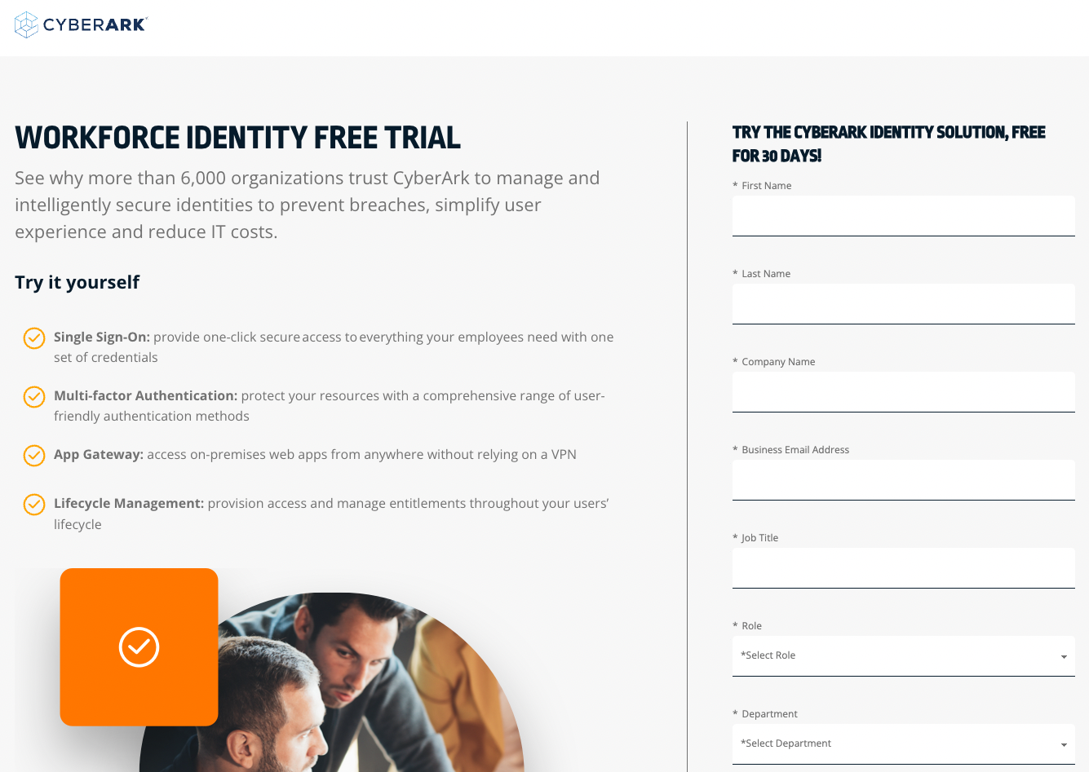
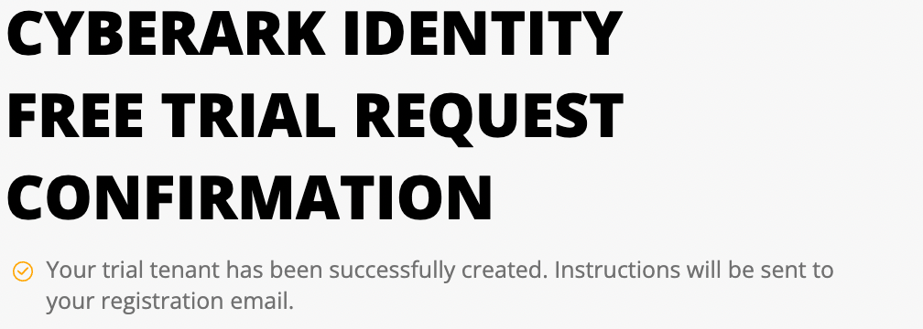
CyberArk Workforce Identity
In this workshop we will configure Single Sign On (SSO) authentication, which allows users to access all published applications with a single set of credentials. Then, we'll enable multi-factor authentication (MFA) to add a layer of security control in verifying users' identity. Finally, we will review Workforce Password Management (WPM) and browser extension to capture username/password fields on login pages automatically.
Start by signing up for a 30-day trial of CyberArk Workforce Identity at this url: https://www.cyberark.com/try-buy/workforce-identity-trial/
Continue the process by confirming the code received via email (check spam folder)

Slide 3
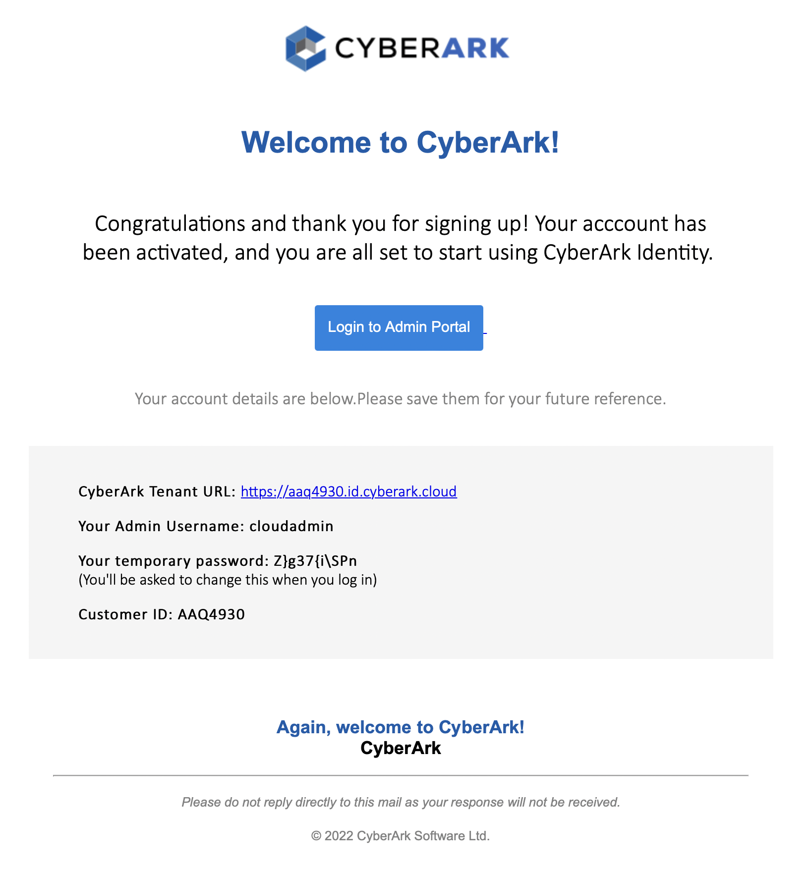
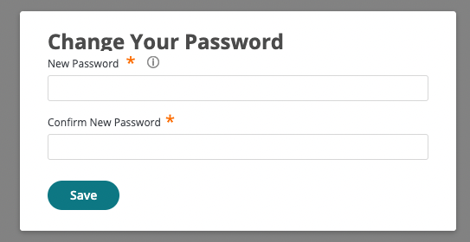

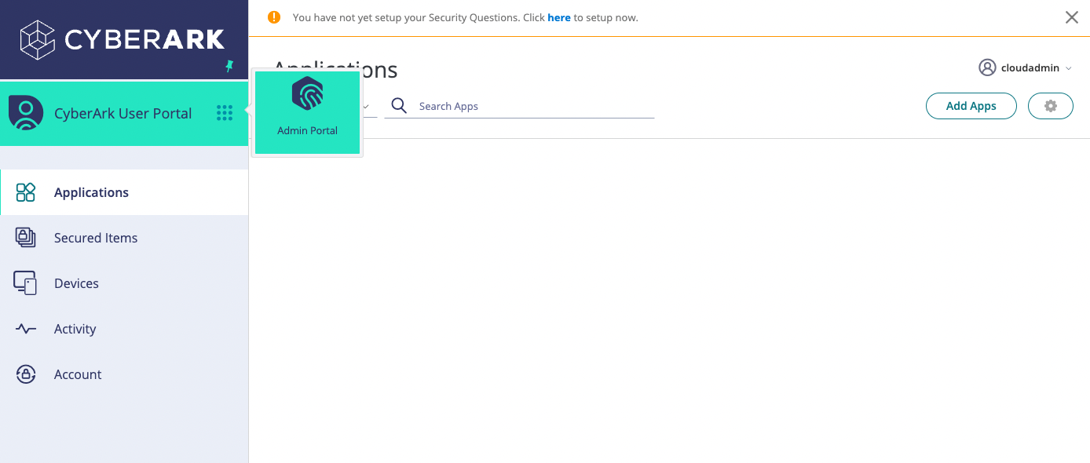
CyberArk Workforce Identity
3. Once registration is complete, you will receive an additional email with instructions to access the Identity administrative portal. When entering for the first time, a password change will be requested, you must comply with the established policy:
4. Ingresar al Admin Portal:

Slide 4
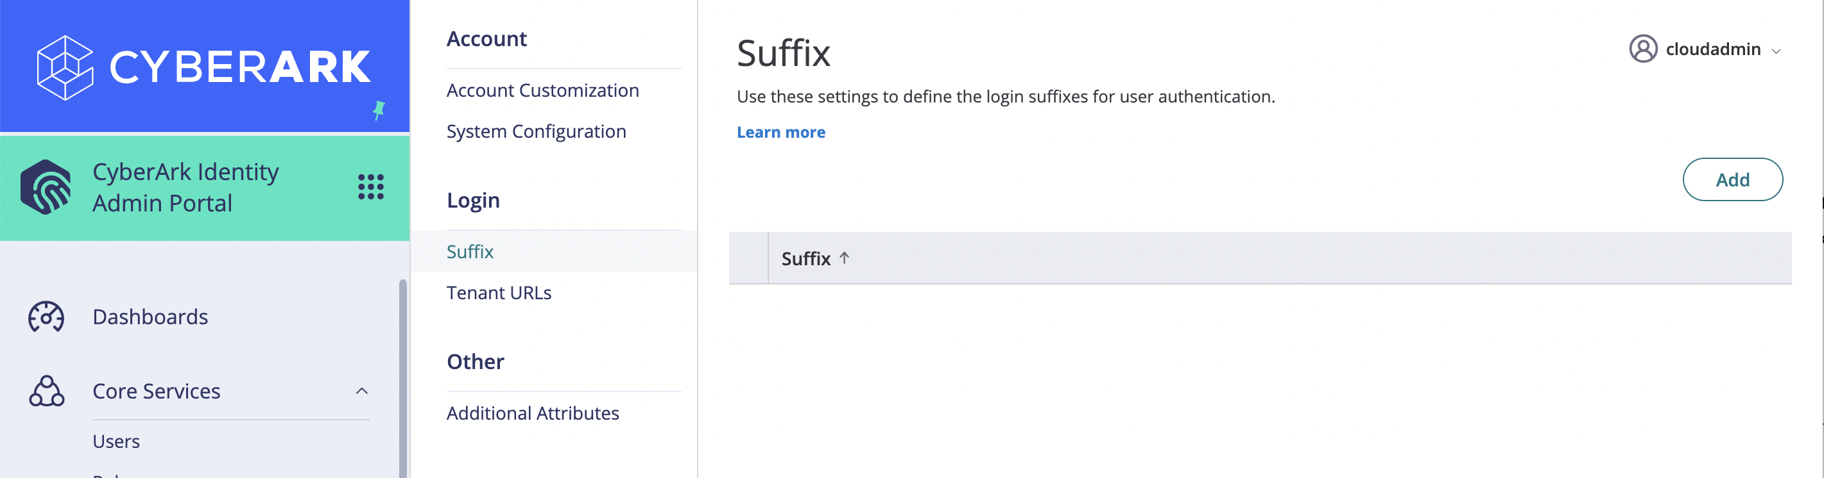
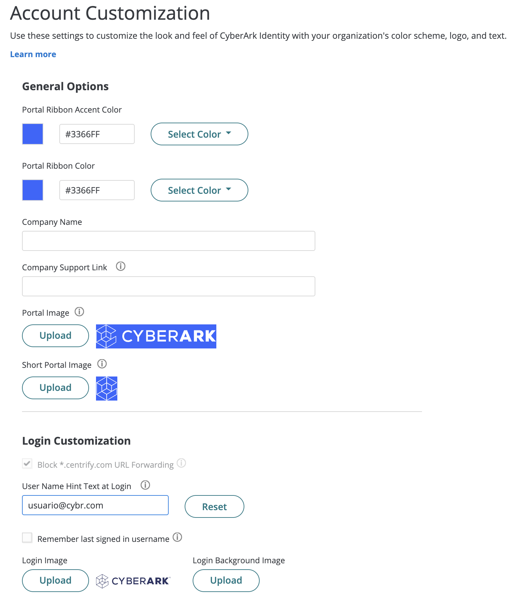
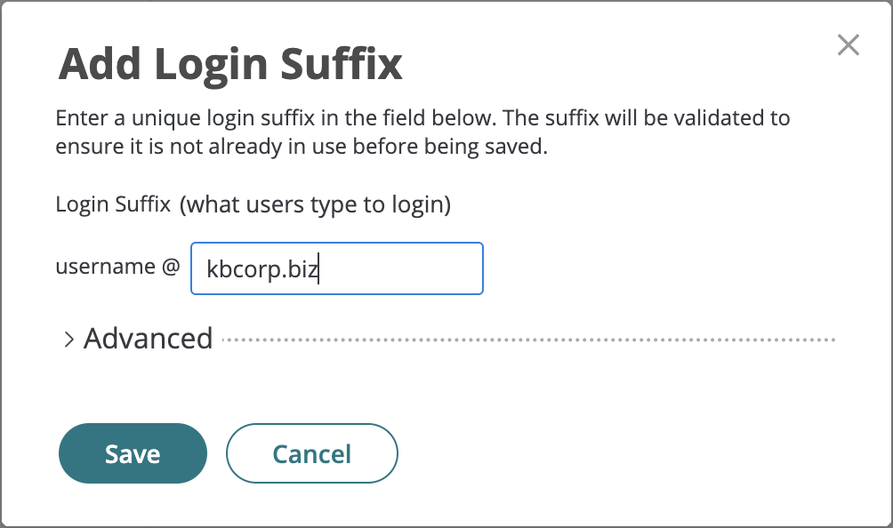
CyberArk Workforce Identity
Tenant Customization
1. In the Admin Portal, main menu, go to Settings | Customization and customize to your liking the General Options (Colors, Portal Images) and Login (wallpaper and logo in login view). In the User Name Hint Text at Login option, specify user@cybr.com (we will integrate the AD from our Skytap lab into our Identity service)
2. In the Login submenu | Suffix, add a new suffix to the environment. The value must be globally unique. Once the suffix is defined, for future authentications with the cloudadmin user we must add it, e.g. cloudadmin@kbcorp.biz

Slide 5
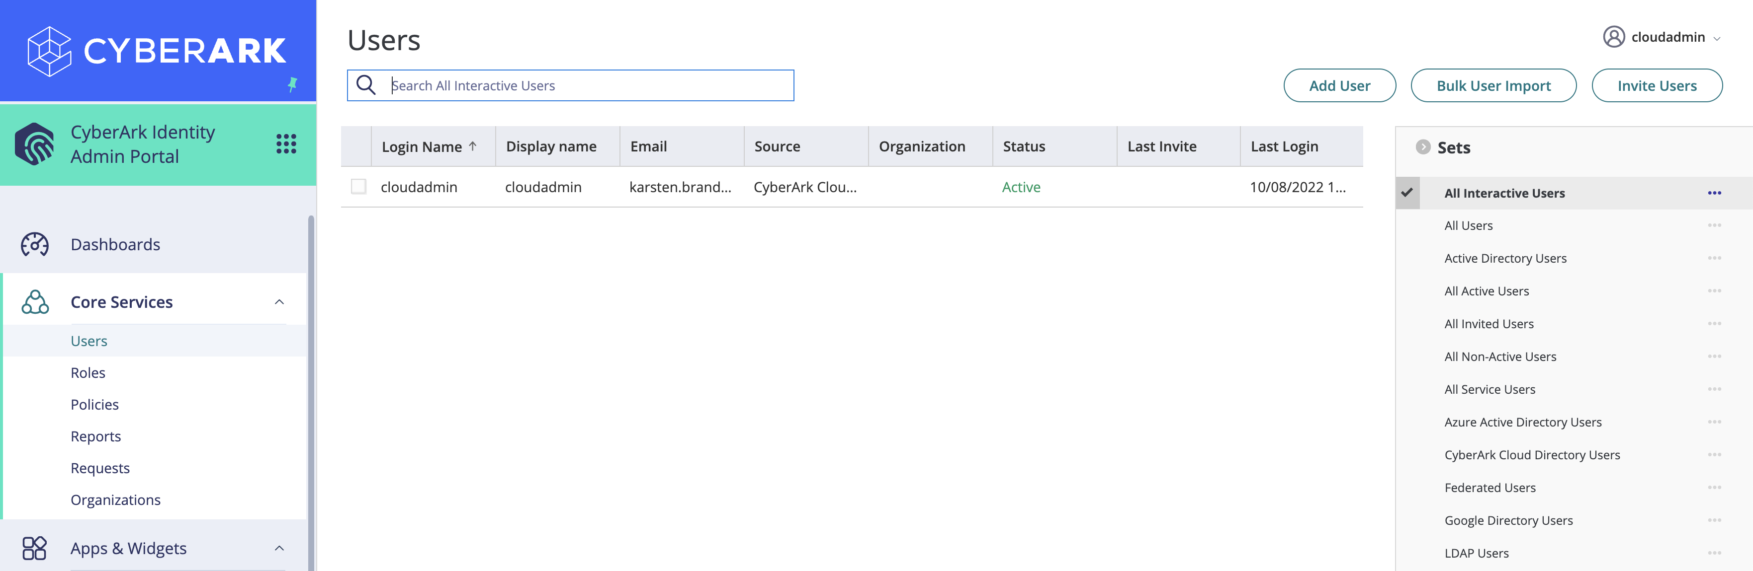
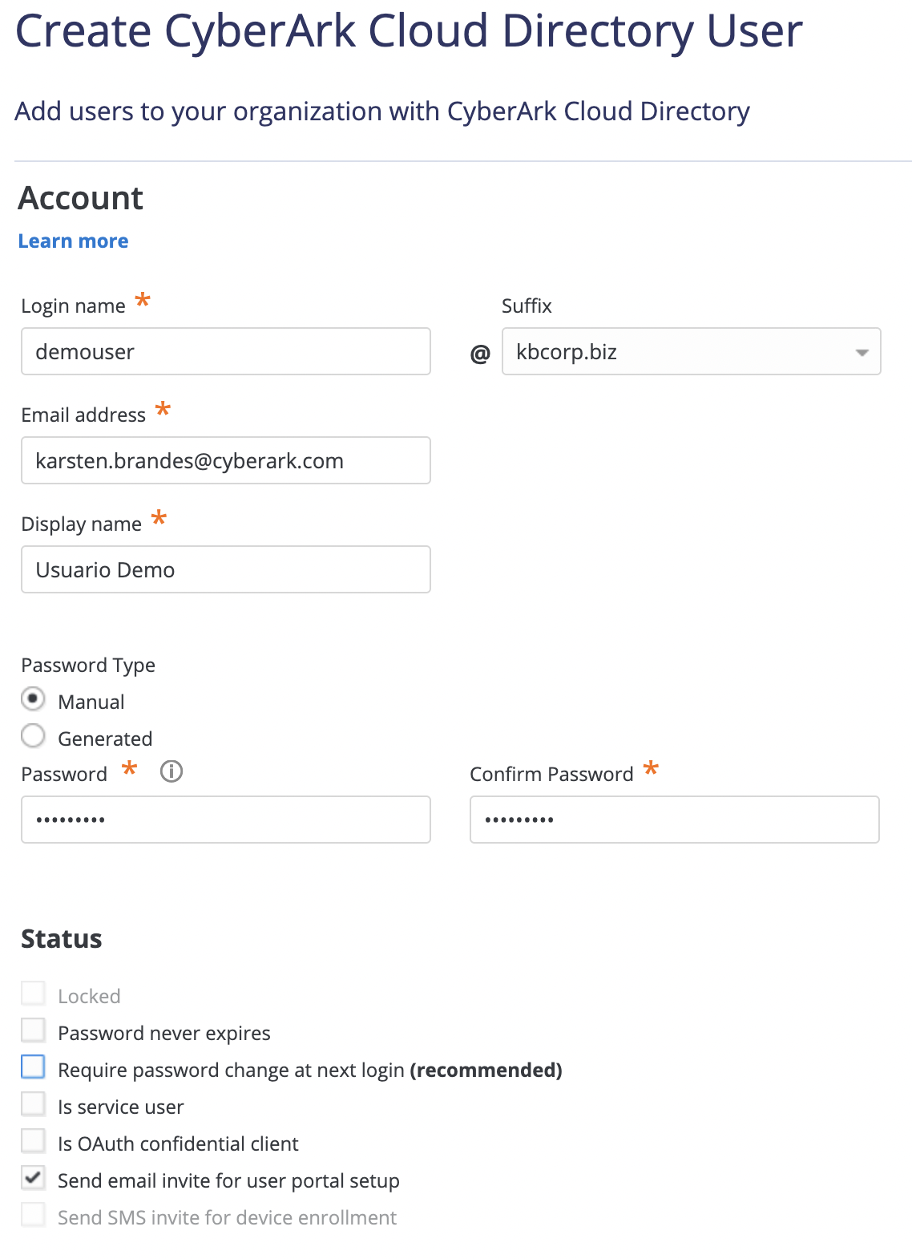
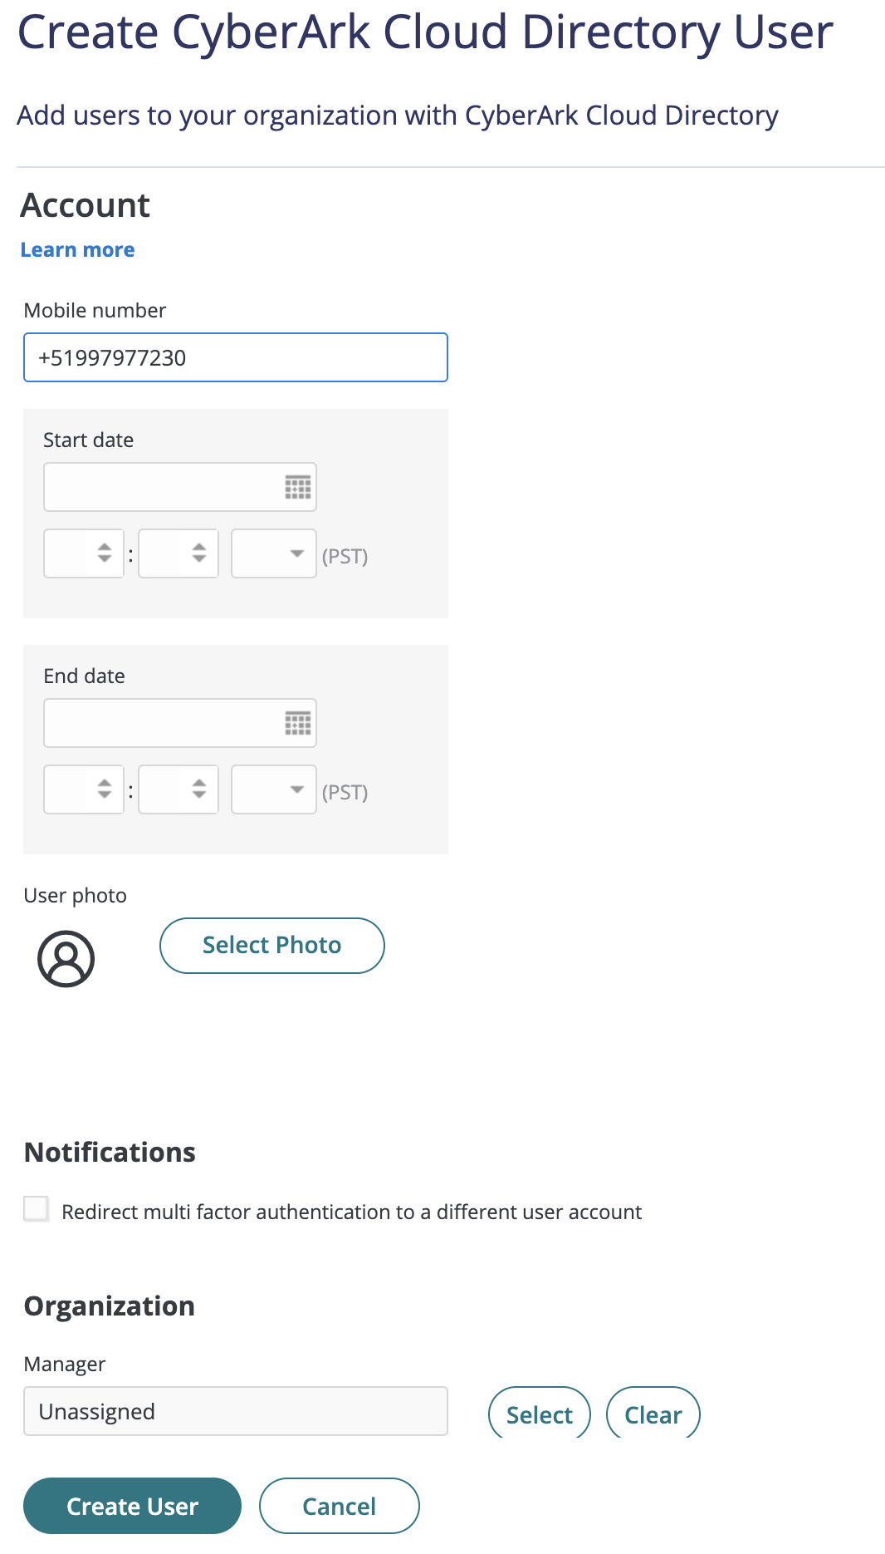
CyberArk Workforce Identity
Tenant Customization
3. For best practices, add a new tenant administrator from the Core Services menu | Users | Add. The cloudadmin user will be stored in a sealed envelope and no multi-factor policies will be applied.
4. In the new user creation form, be sure to add your corporate email address and cell phone, so that you can then perform MFA tests. Assign a password manually and disable the Require Password change at next login option.

Slide 6
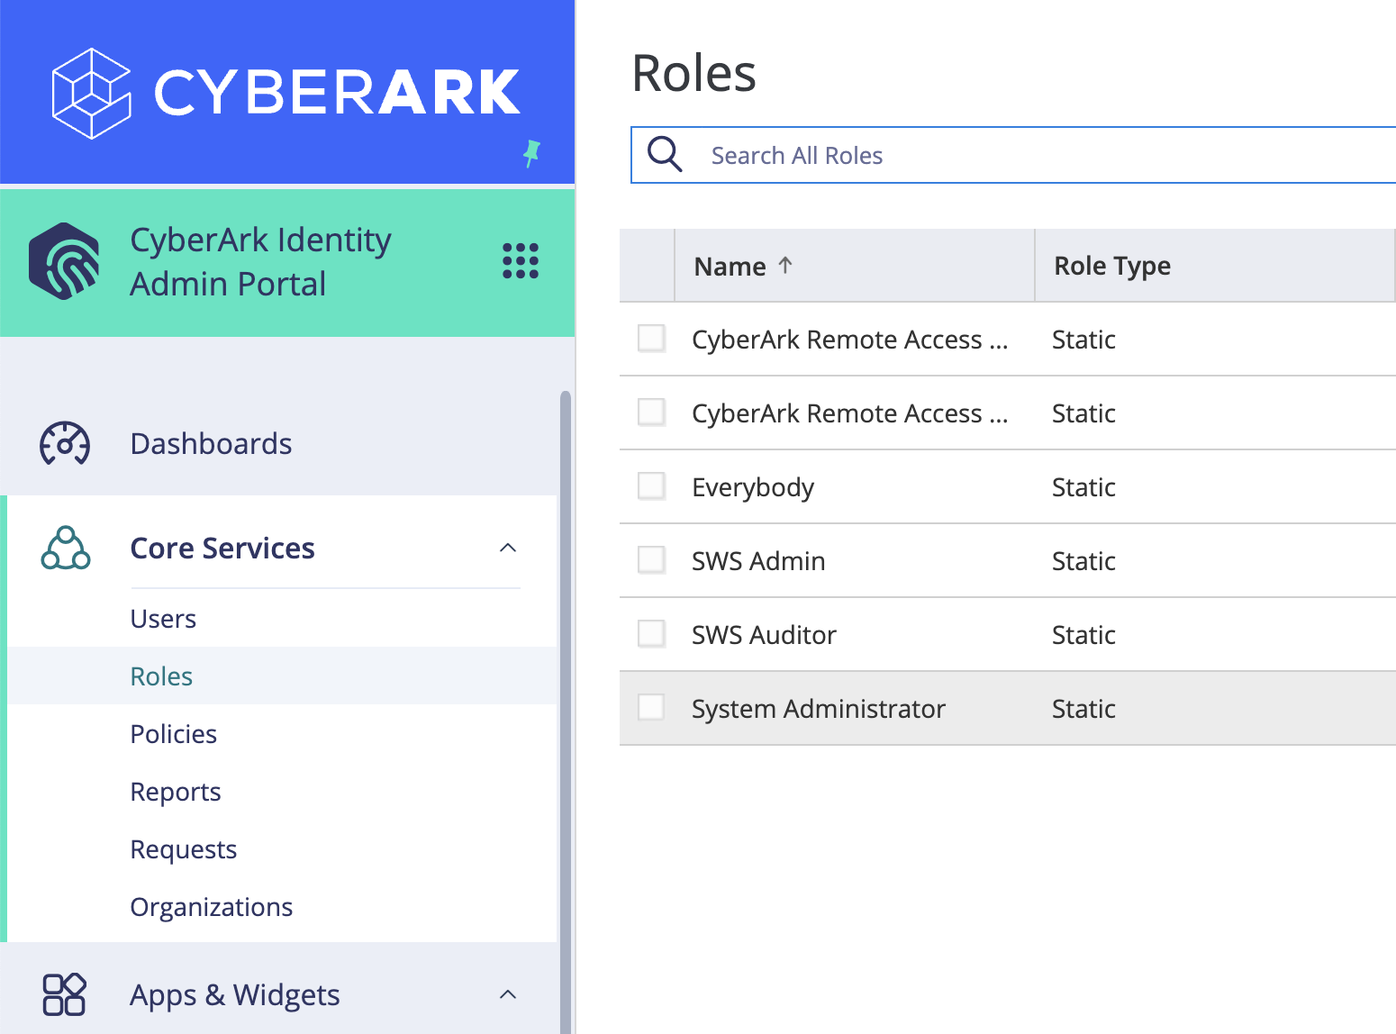
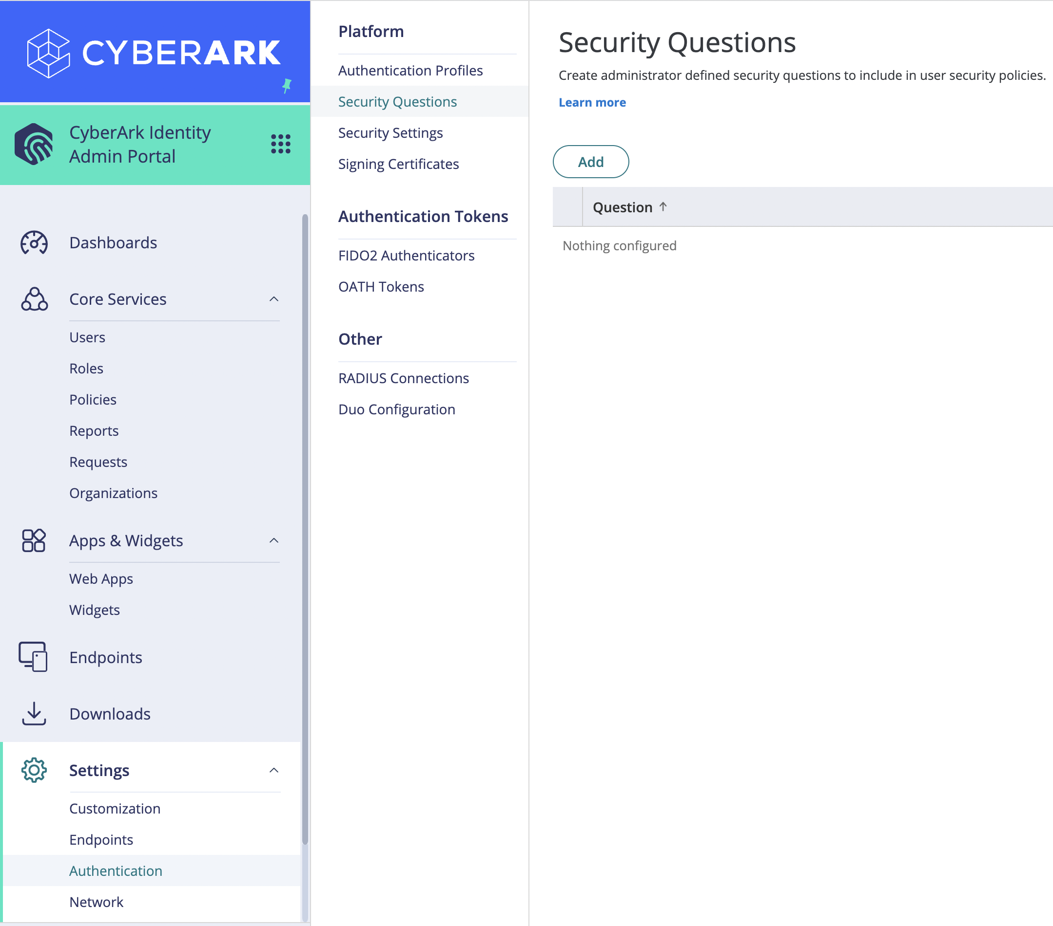
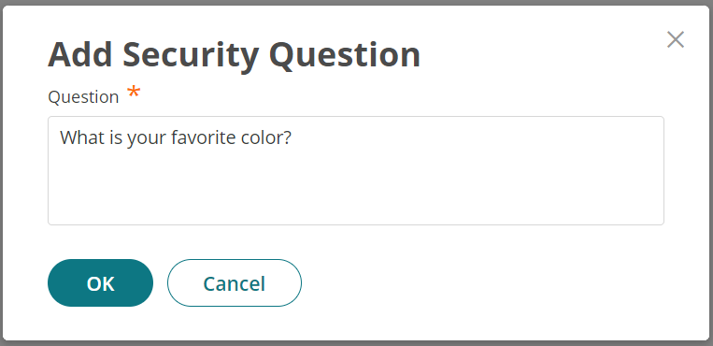
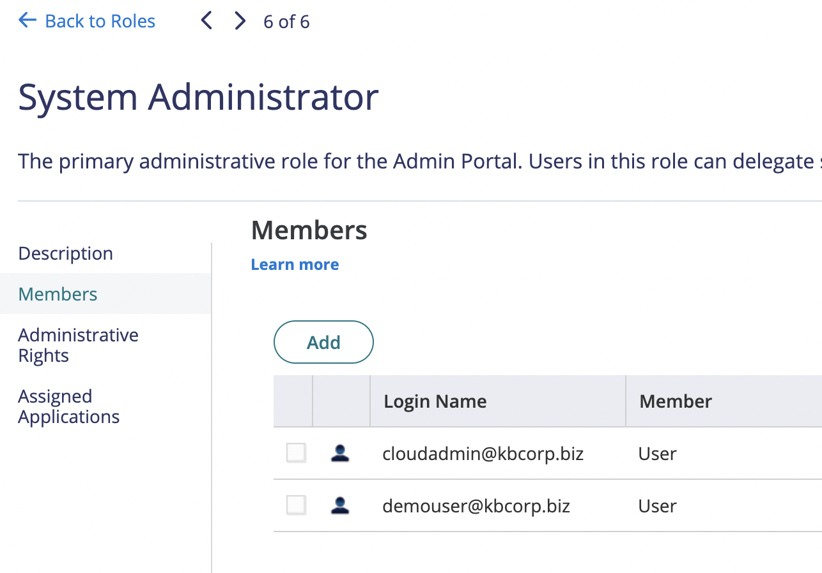
CyberArk Workforce Identity
Tenant Customization
5. To add the new user as a tenant administrator, go to Core Services | Roles and select the System Administrator role. Add the new account.
6. Go to Settings | Authentication | Security Questions and add a security question that we will then ask for as part of our users' registration.

Slide 7
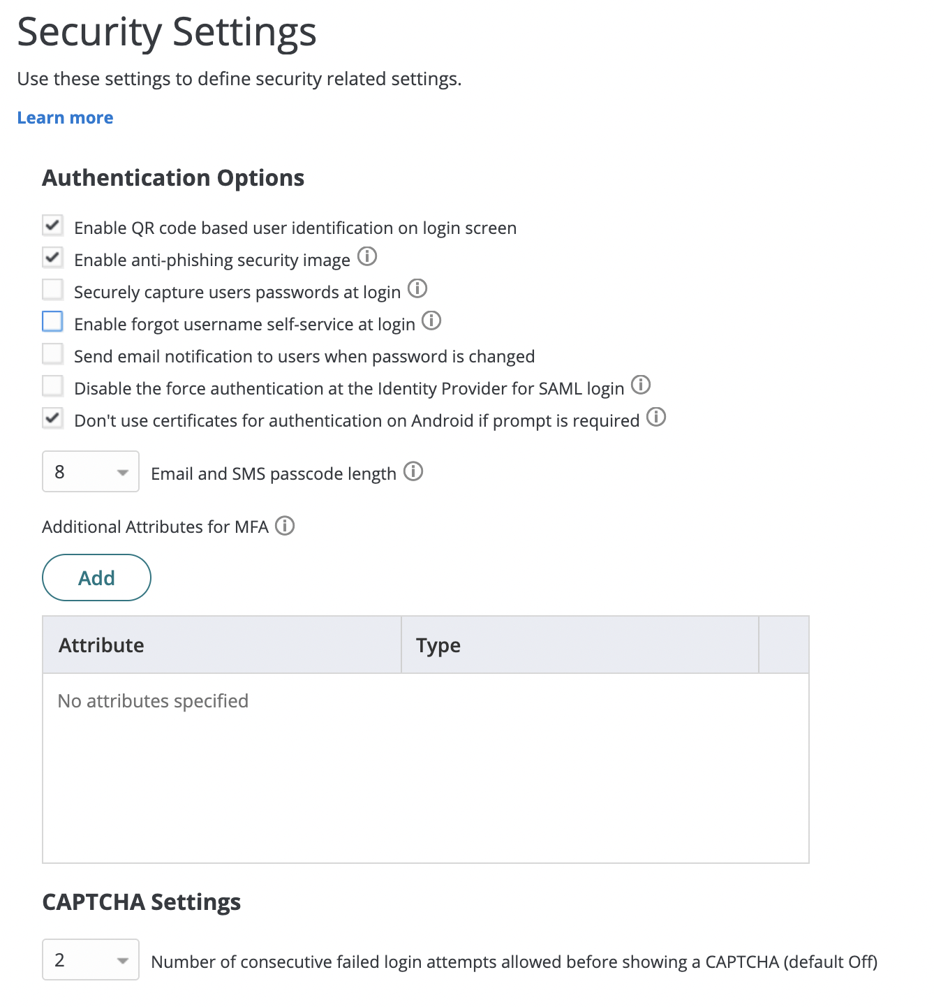
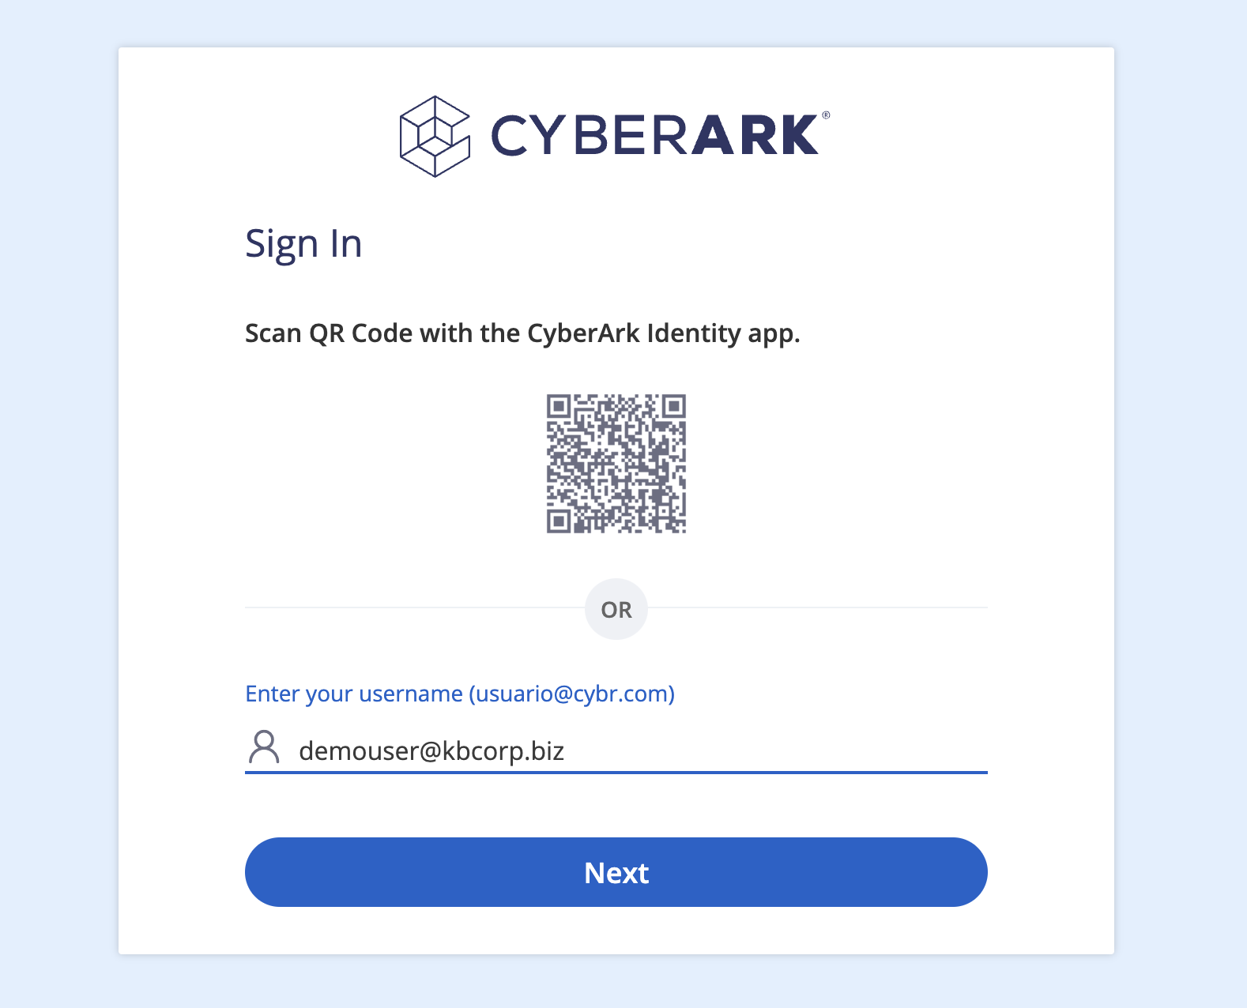
CyberArk Workforce Identity
Tenant Customization
7. In Security Settings, review and enable the following options, finally click Save:
8. Authenticate to the portal with the newly created user. Note that we have enabled the QR code on the authentication screen, and also text help for our end users of the cybr.com

Slide 8
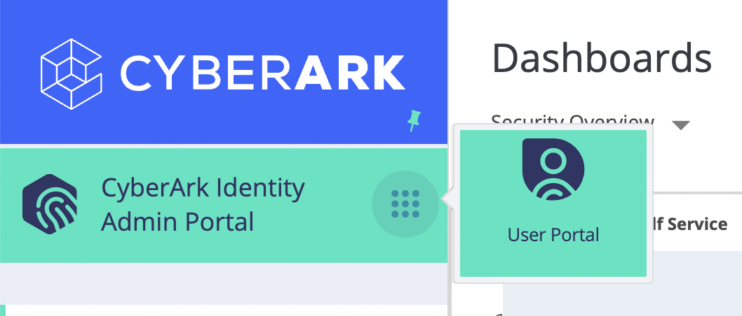
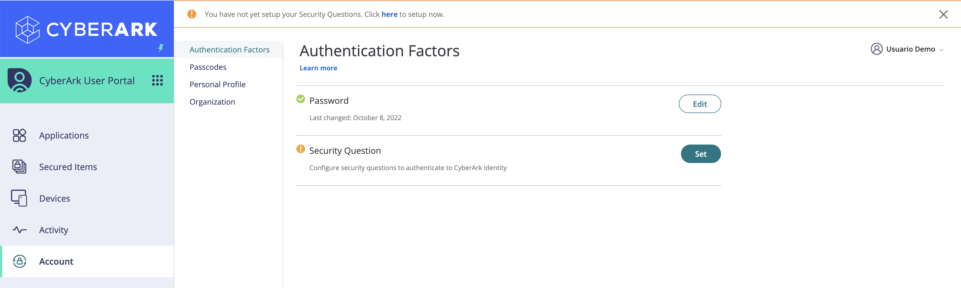
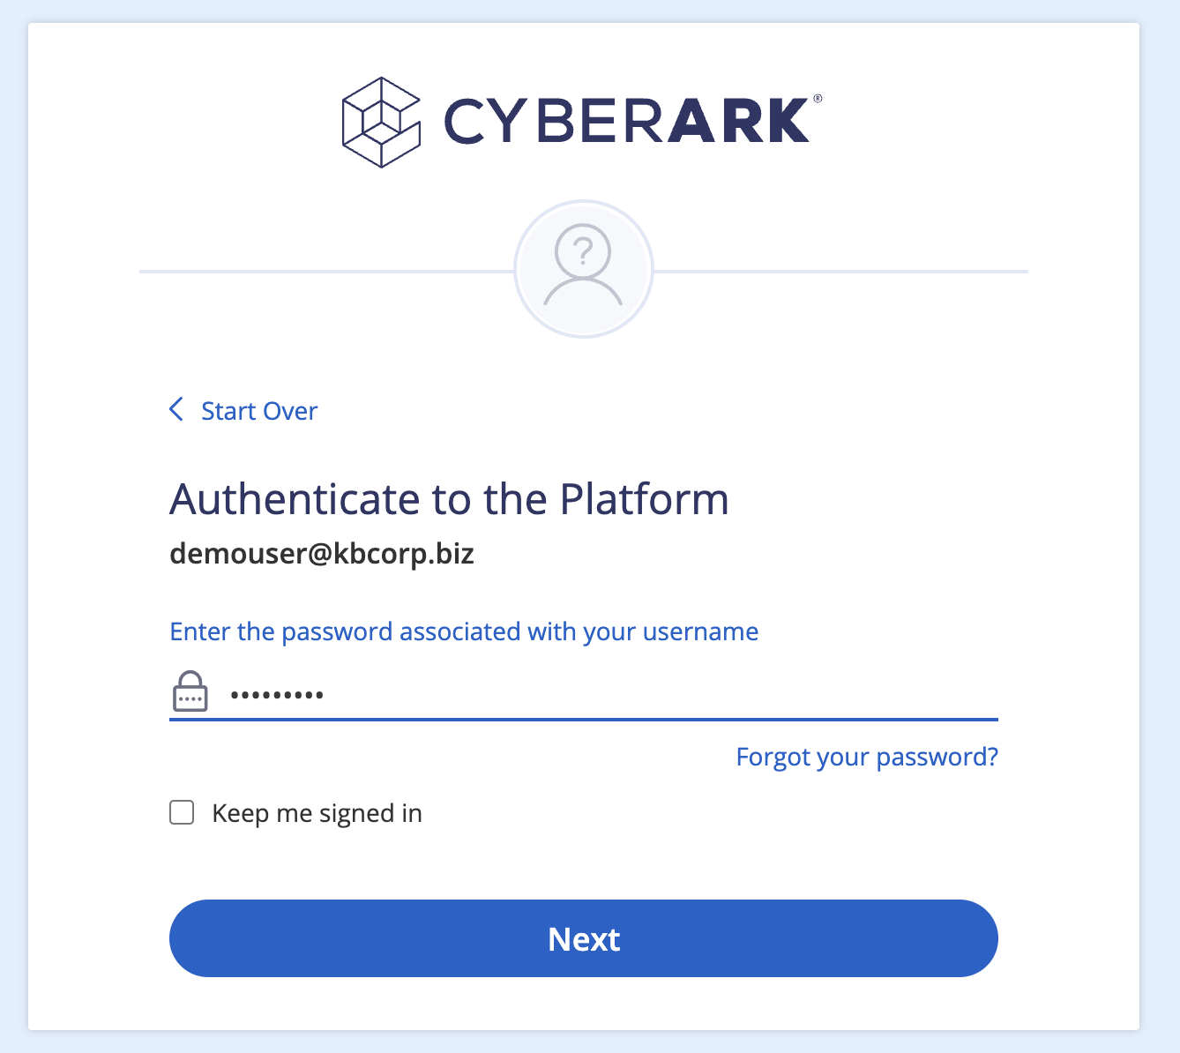
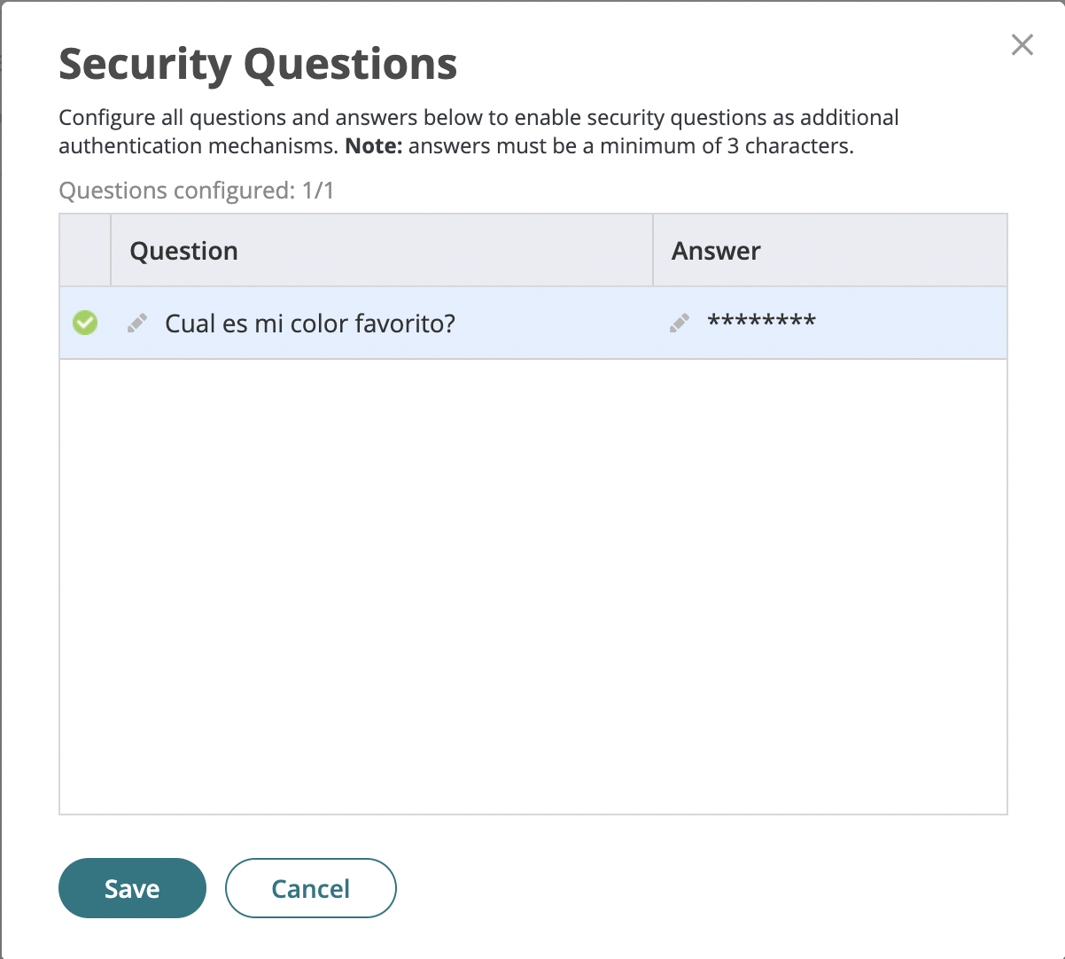
CyberArk Workforce Identity
Tenant Customization
9. We have not yet applied multi-factor authentication policies or defined our answers, note that it only asks us for the password.
10. In the User Portal, select Account | Authentication Factors and add a security question.

Slide 9
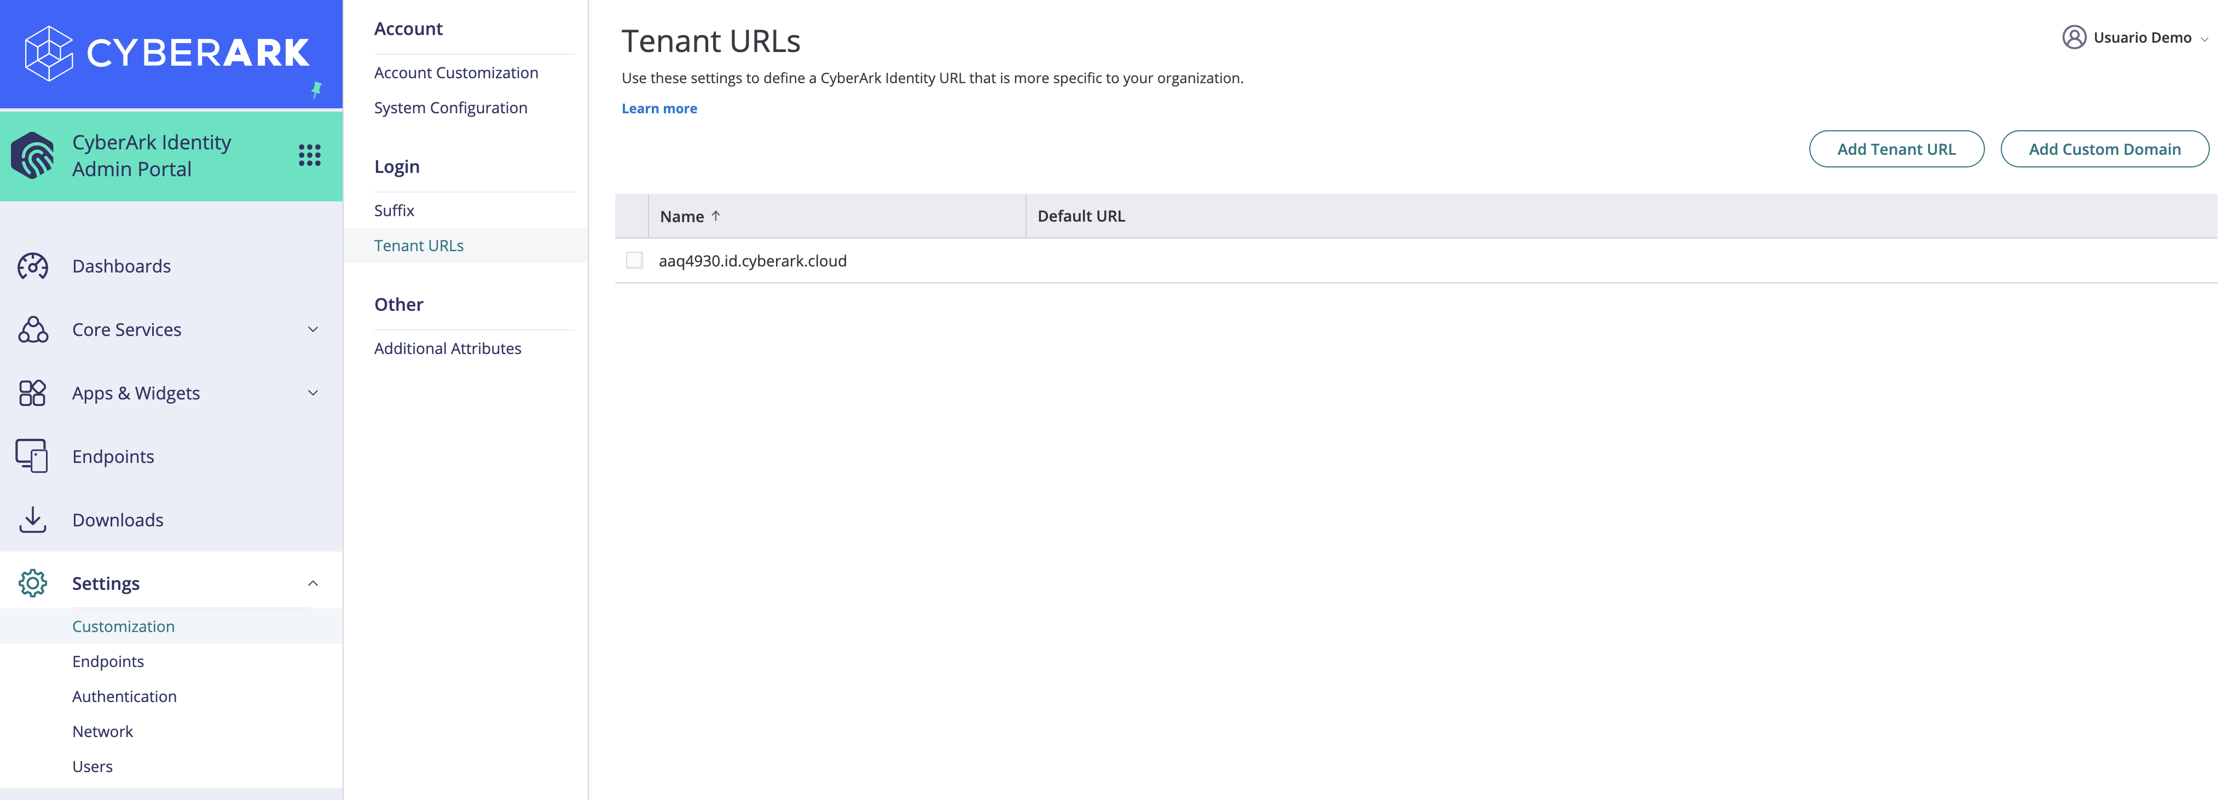
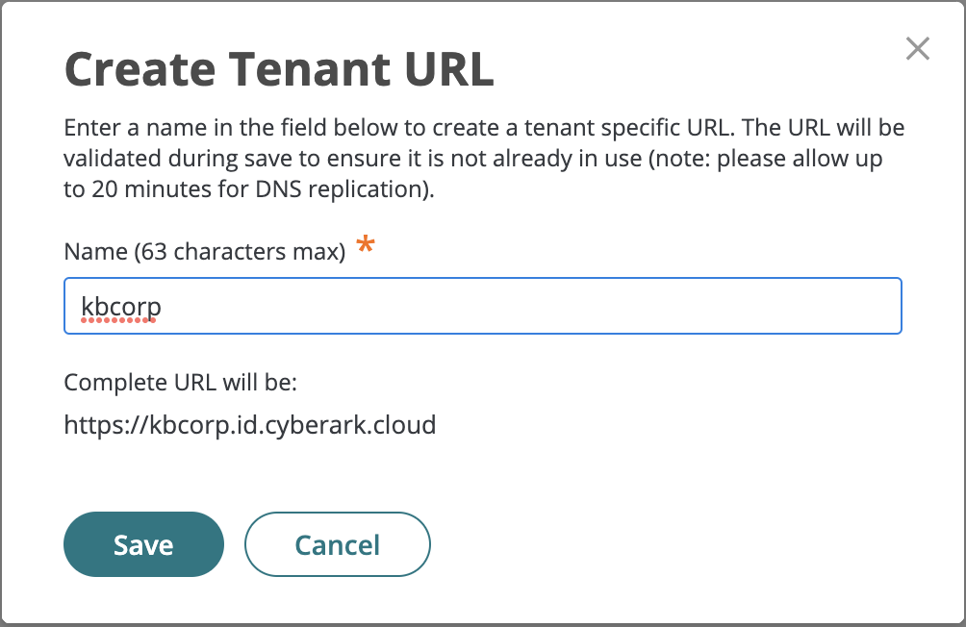
CyberArk Workforce Identity
Tenant Customization
11. Finally we will create a URL to access the Tenant that is more friendly for our organization. In the Admin Portal, go to Settings > Customization > Tenant URLs menu and select the Add Tenant URL button. Specify a unique name for your Tenant. The new URL may be used by our end users to access the service:

Slide 10
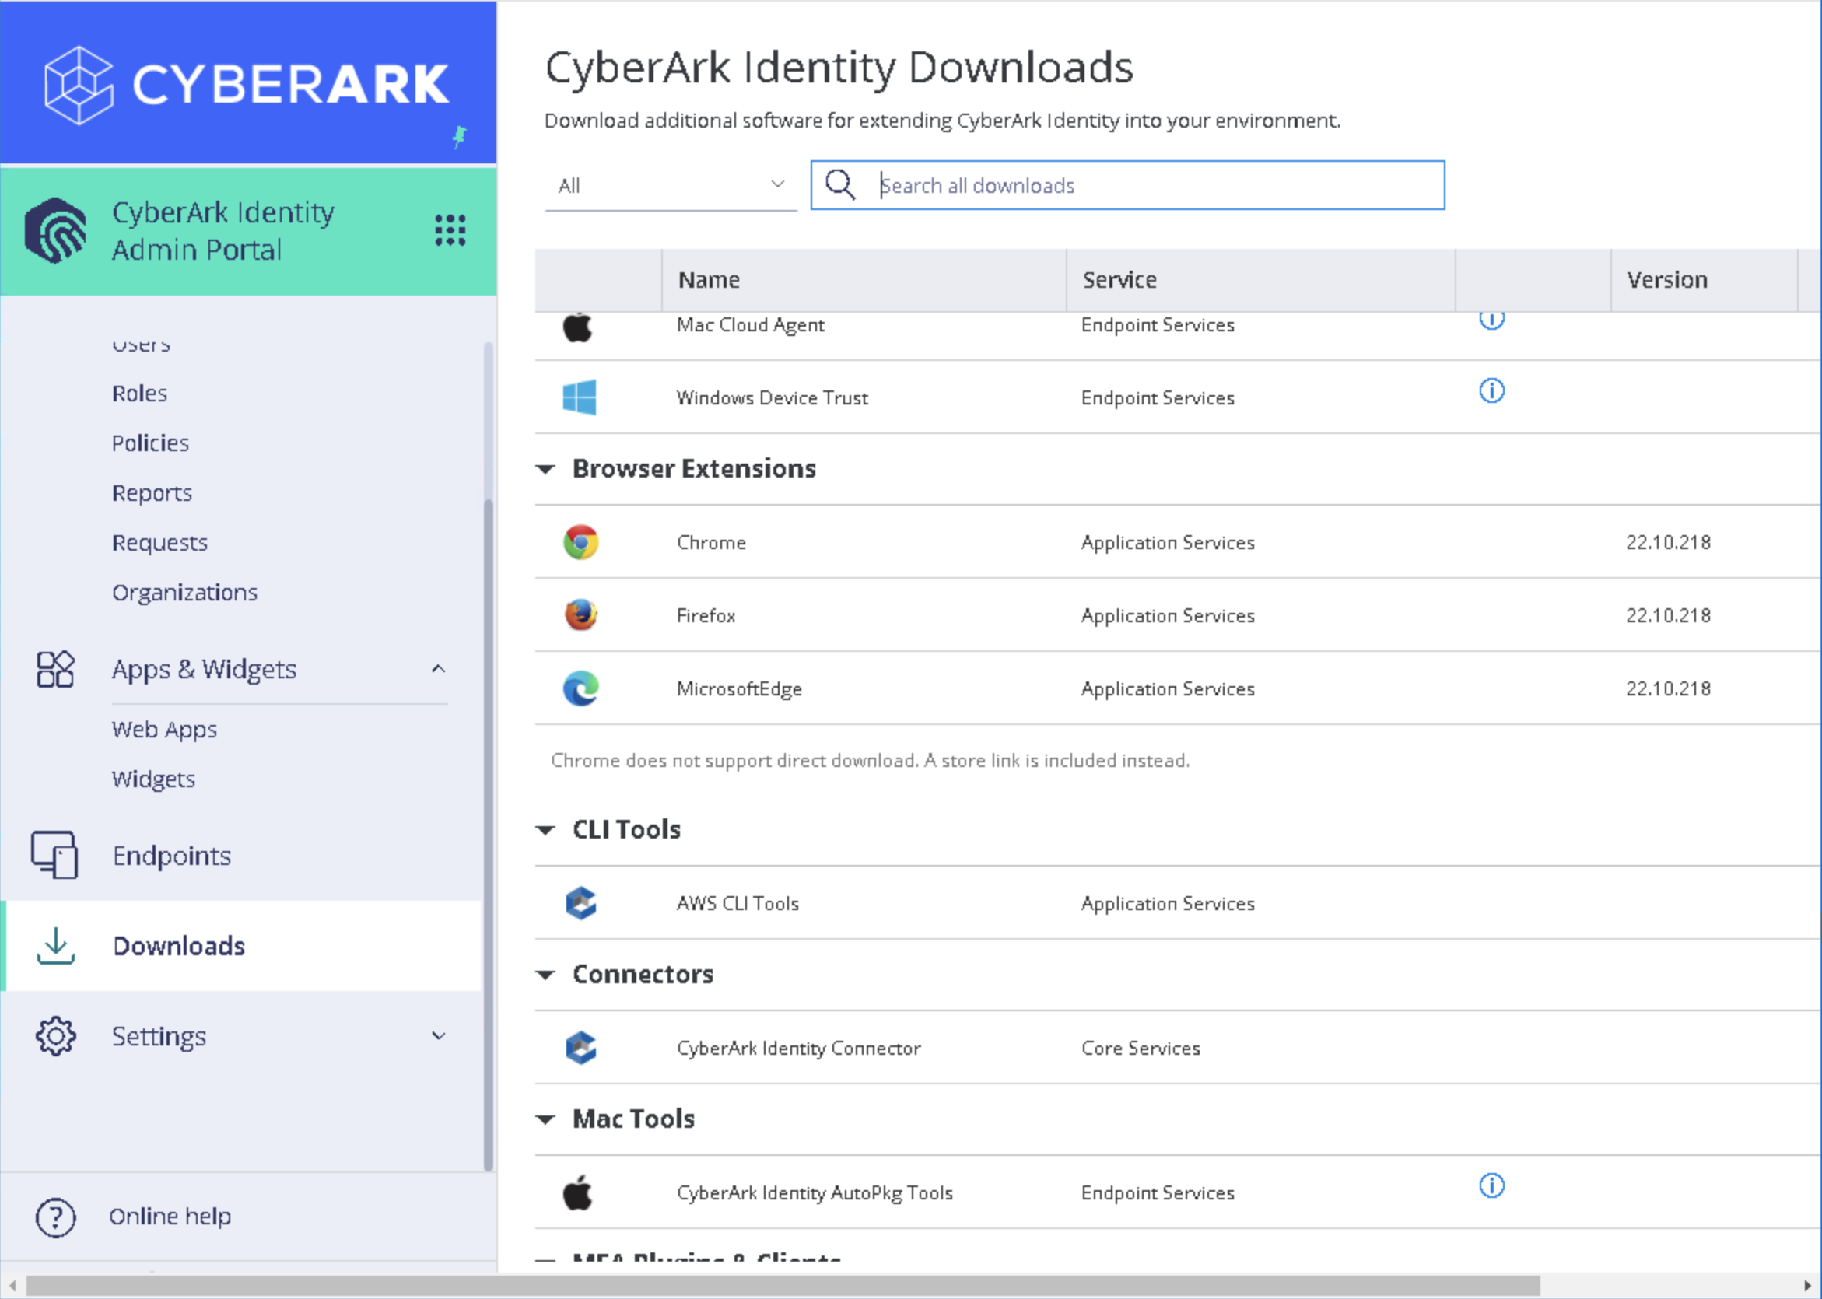
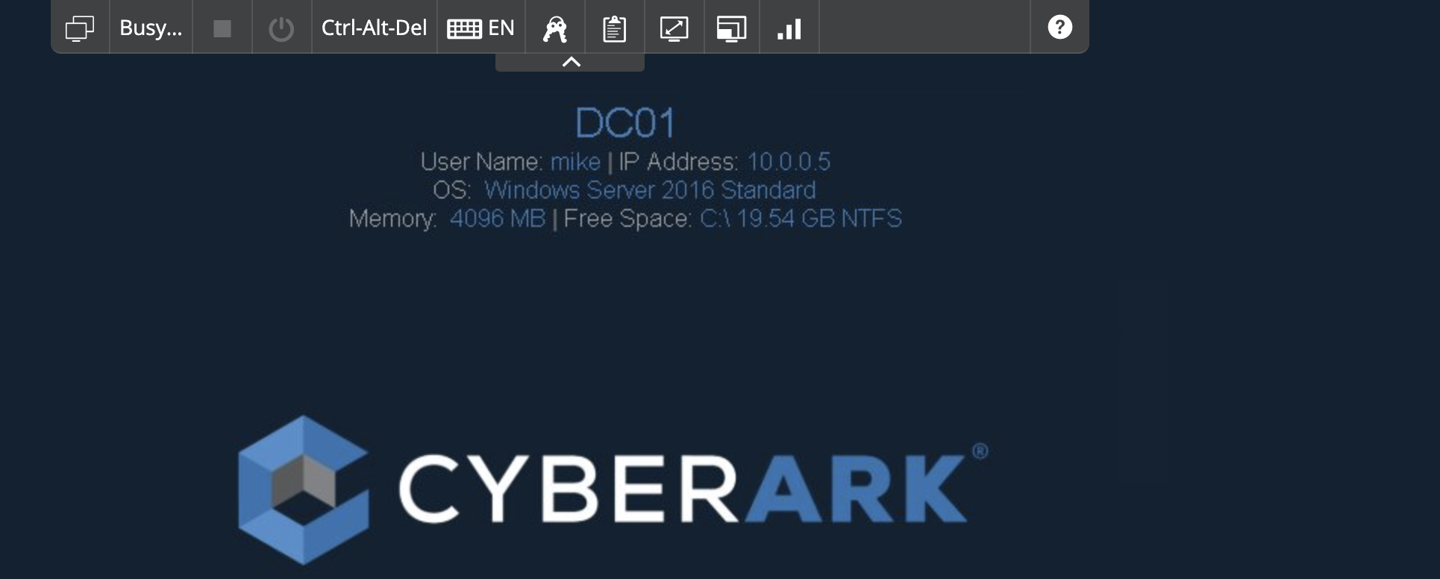
CyberArk Workforce Identity
Installing the Identity Connector
1. We will install the Identity connector in our Skytap environment to be able to integrate the Active Directory of the organization so that our corporate users can take advantage of the features of SSO/MFA/WPM/App Gateway. In Skytap, login to the DC01 server using Mike’s credentials (Cyberark1)
2. Open Chrome and authenticate to the Identity Admin Portal with the newly created user (system administrator role). Select the Downloads menu and download the CyberArk Identity Connector
Note: In production environments, installing the connector on Domain Controllers is not recommended.

Slide 11
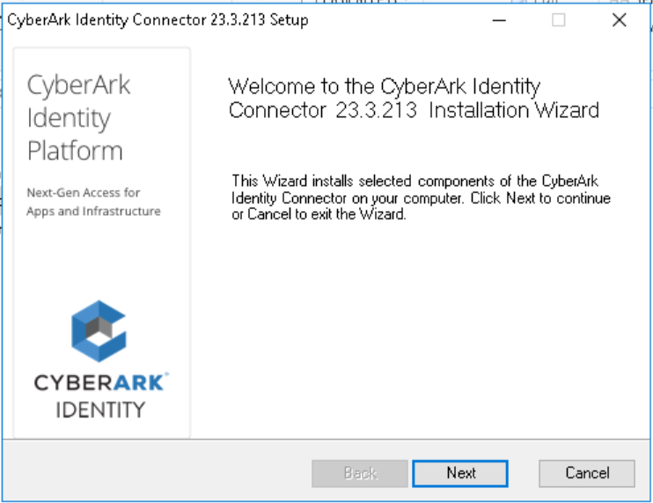
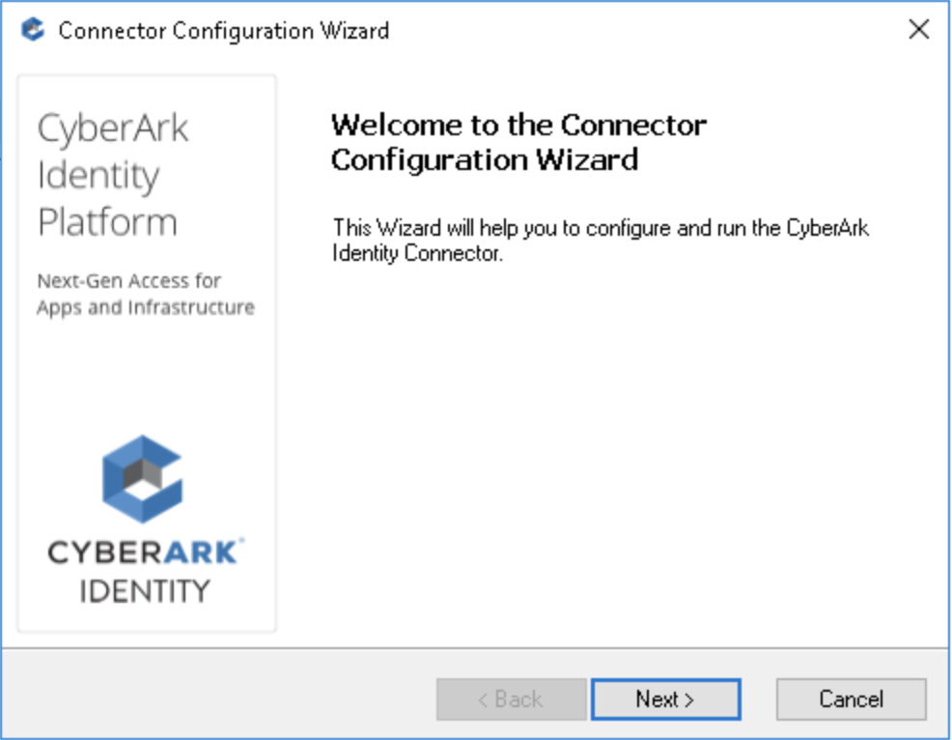
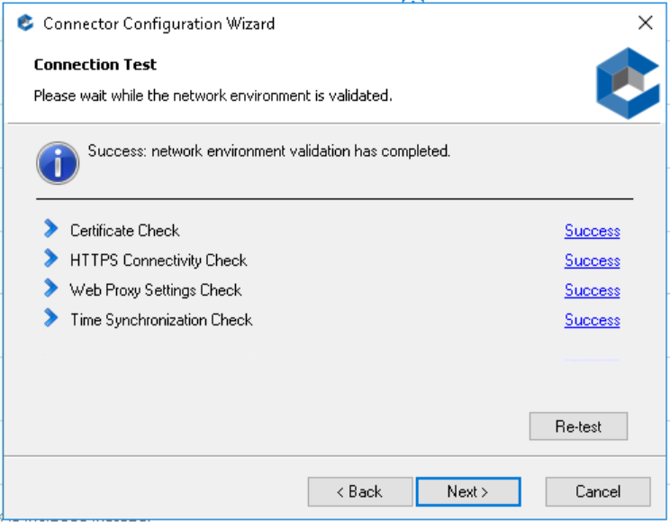
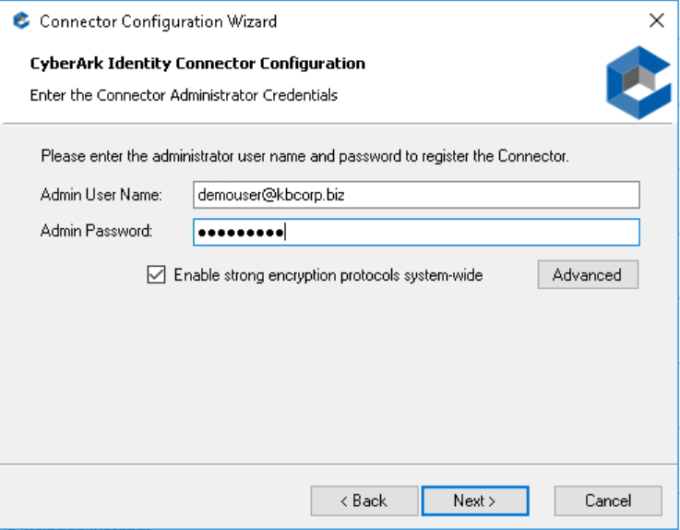
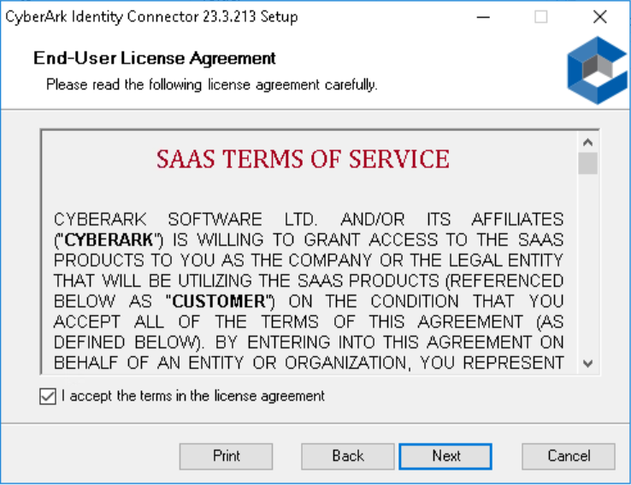
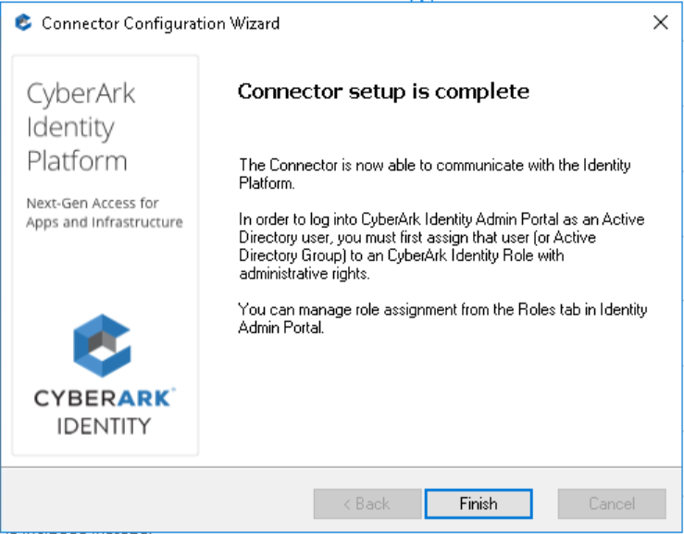
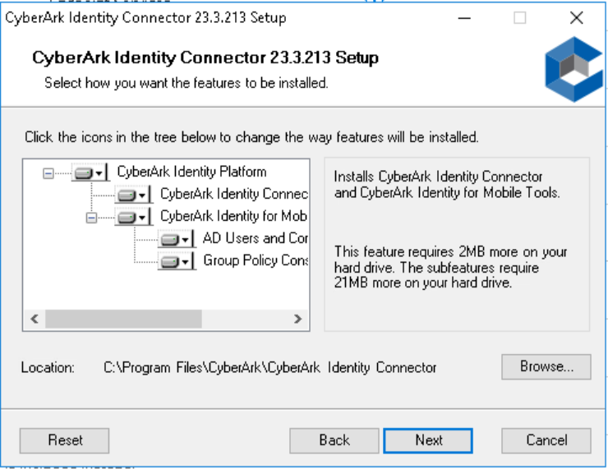
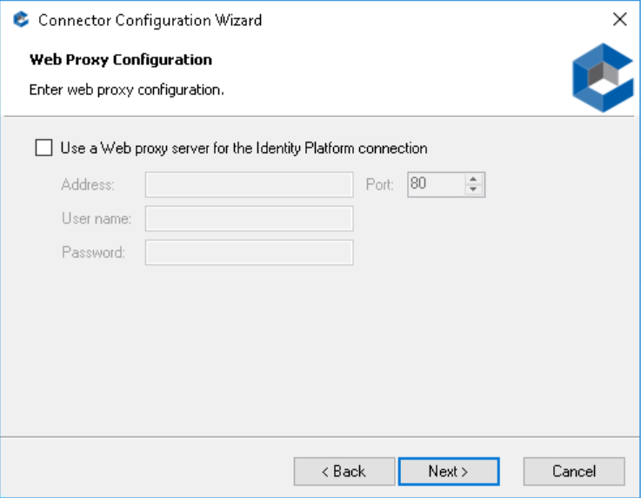
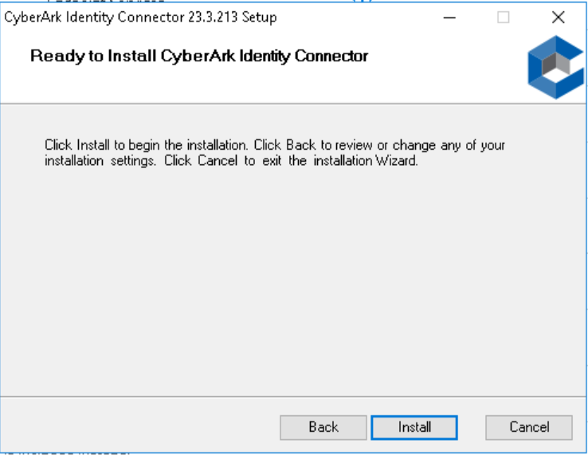
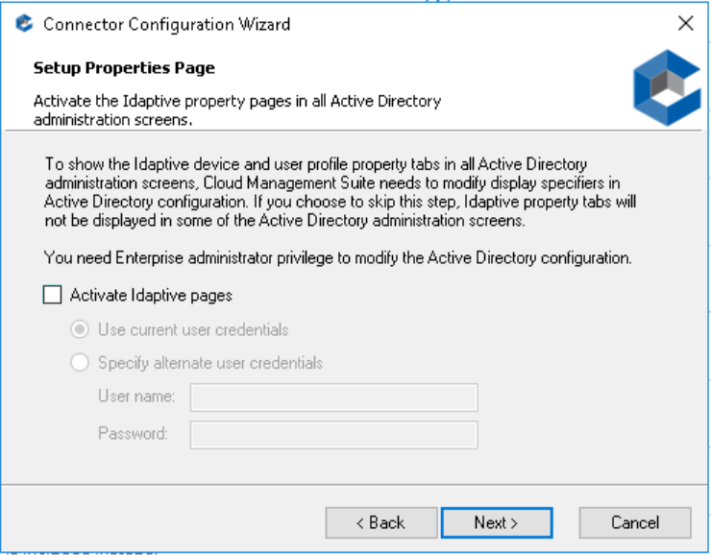
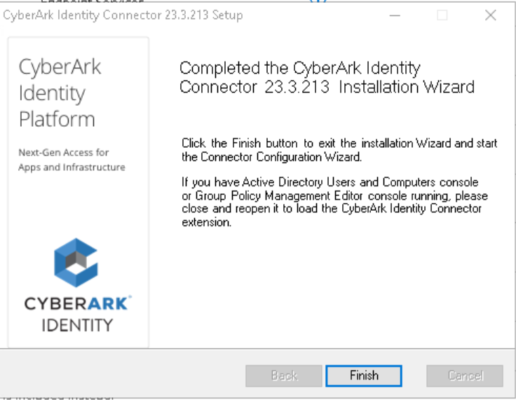
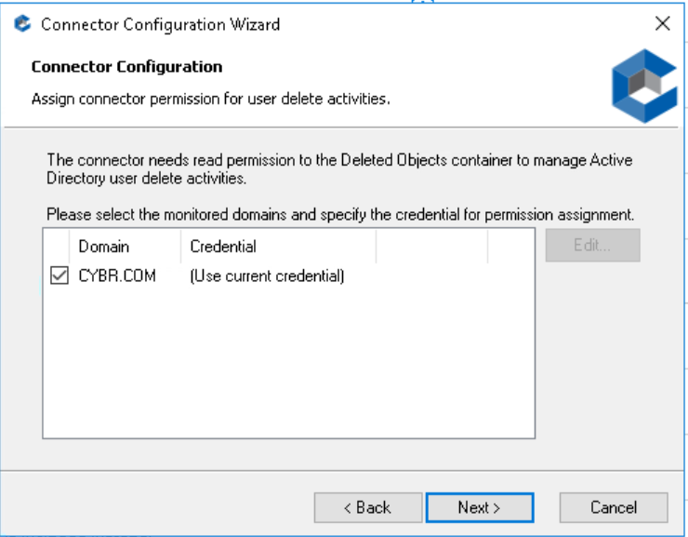
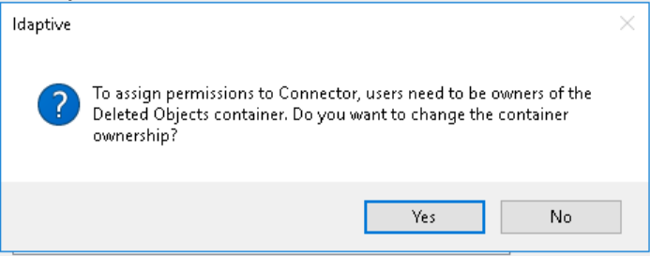
CyberArk Workforce Identity
Installing the Identity Connector
3. After downloading the file, unzip it and run the Connector installer. Accept the terms of service, enable all options, and select the Install option
4. In the Configuration Wizard, specify the newly created admin user, we need to get 4 successes and then verify the successful completion of the install.

Slide 12
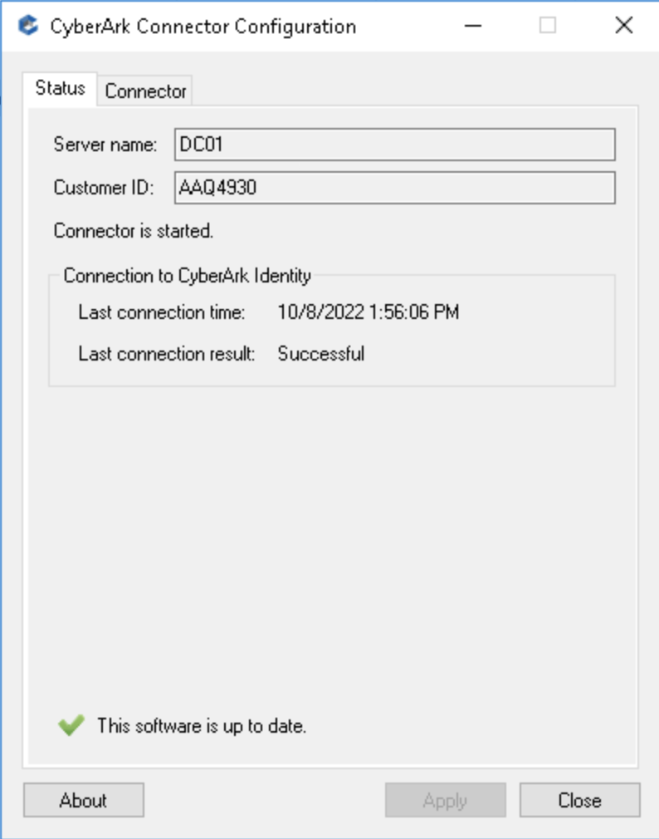
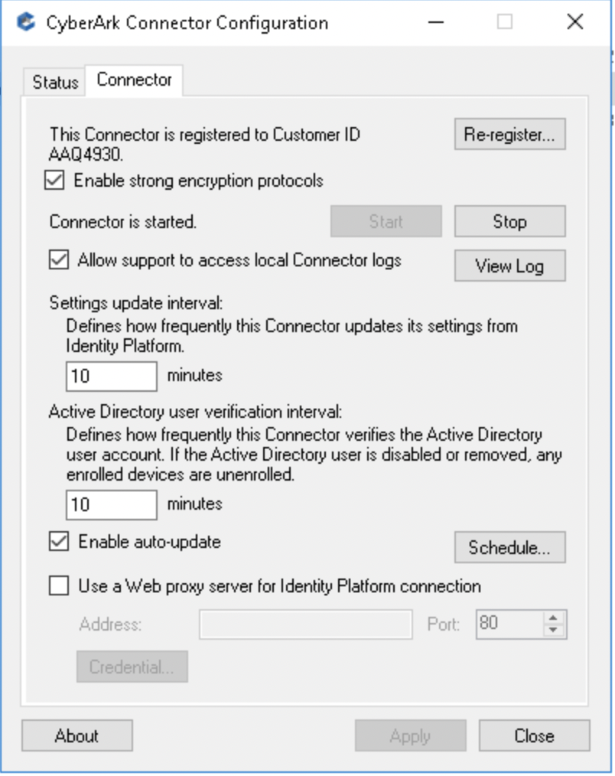
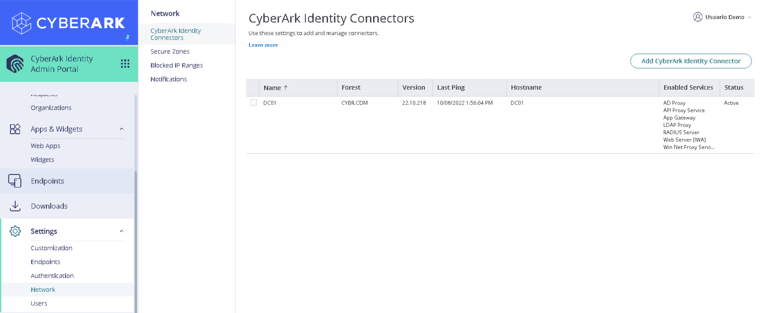
CyberArk Workforce Identity
Installing the Identity Connector
5. In the CyberArk Connector Configuration window, verify the time of the last connection, server name, and customer ID. Review the options available on the Connector tab.
6. In the Admin Portal, go to Settings | Network | CyberArk Identity Connectors and verify that the connector is listed as Active. Review the services that are enabled by default.
IWA Service: Integrated Windows Authentication, allows users already authenticated on their workstations to access the Identity portal automatically without the need for re-autenticate.
App Gateway: Access internal web applications from the SSO portal without the need to connect via a VPN

Slide 13
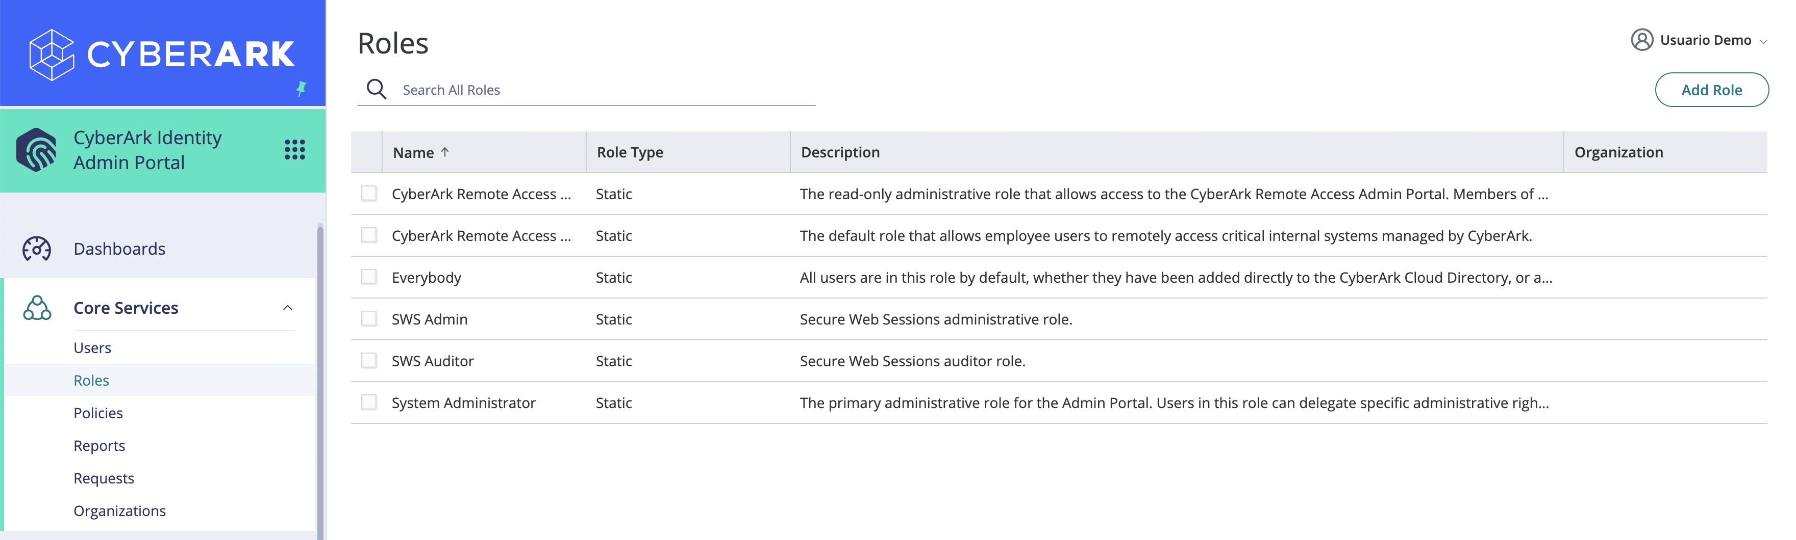
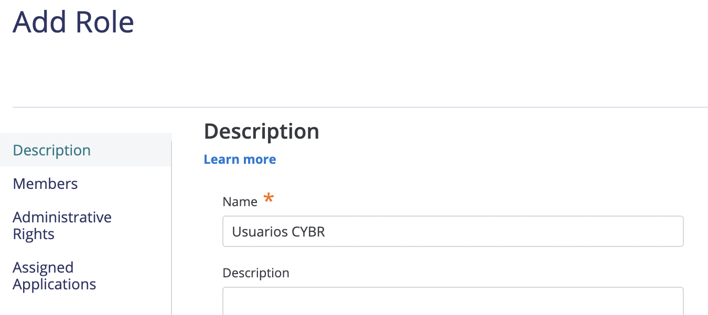
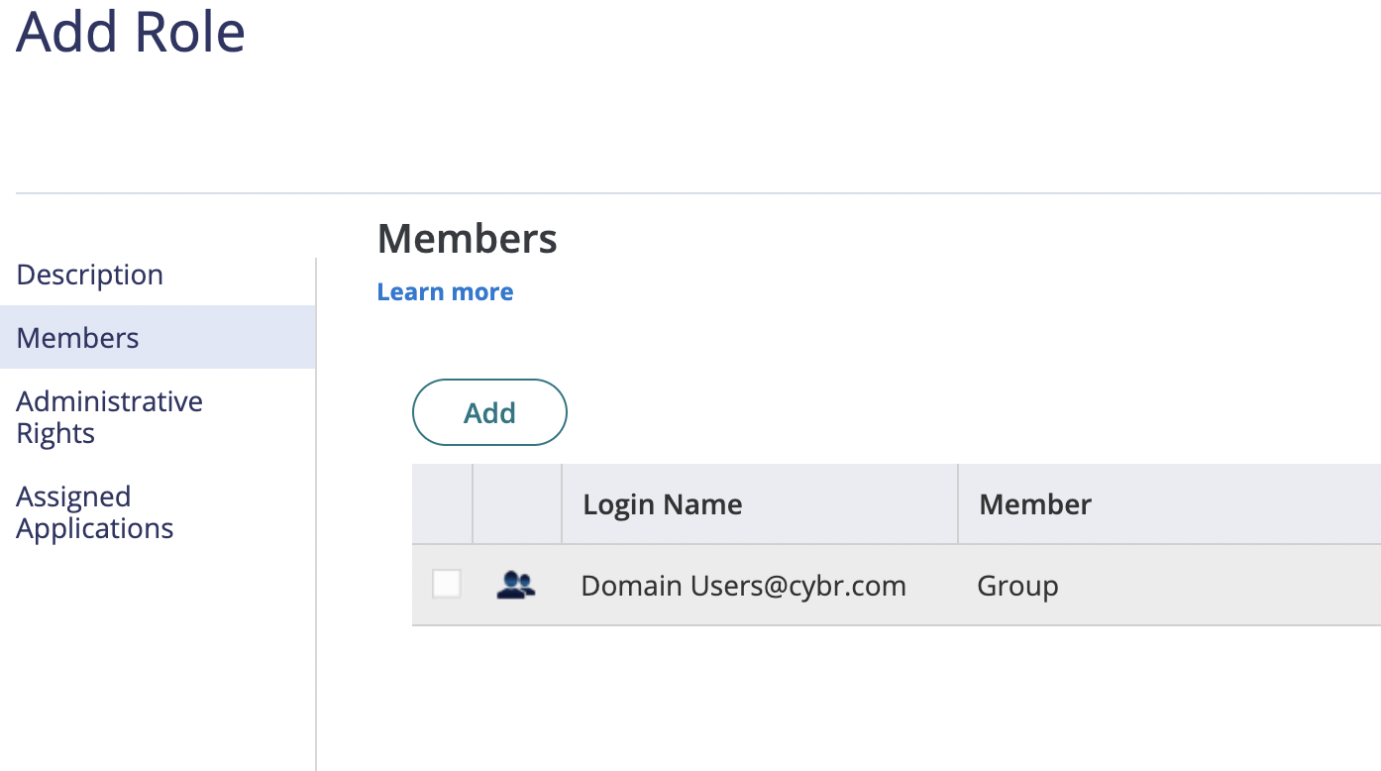
CyberArk Workforce Identity
Creating Roles and Policies
Policy-based access control, also known as Attribute-based Access Control (ABAC) is a strategy for managing user access to one or more systems, where users' business roles are combined with policies to determine the access and privileges that users in each role must have. The Default Policy is the policy that is configured by default in our tenant. In this lab we will create a new policy that will be assigned to users of the CYBR.COM domain.
In the Admin Portal, go to Core Services | Roles. We will create a new role for users in our organization's Active Directory.
On the Description menu, specify a name for the new role, and under Members, add the Domain Users group of the active directory CYBR.COM

Slide 14
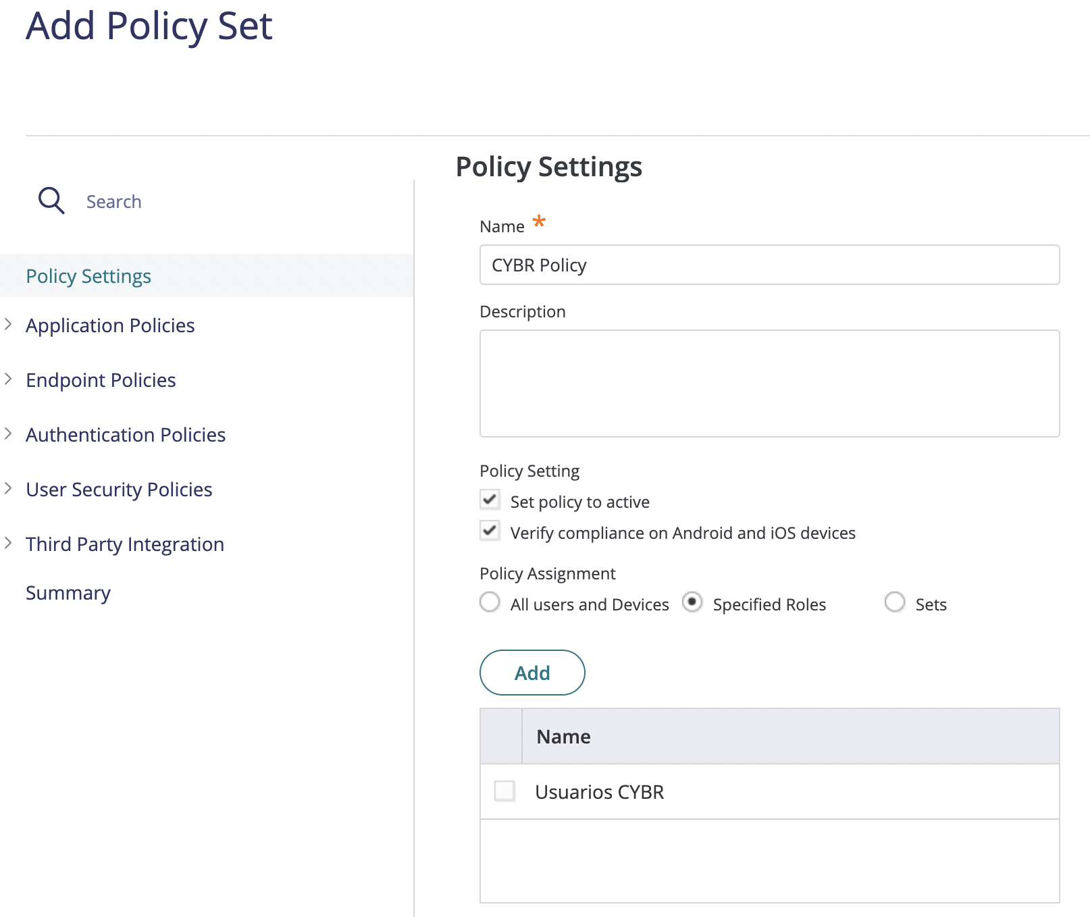
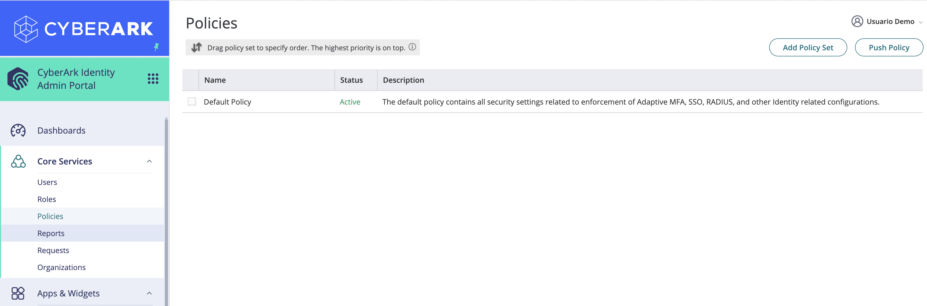
CyberArk Workforce Identity
Creating Roles and Policies
3. In the Admin Portal, go to Core Services | Policies and review the properties of the Default Policy. Then, add a new policy.
4. In the Policy Settings menu, specify a name for the new policy and assign it to the newly created role:

Slide 15
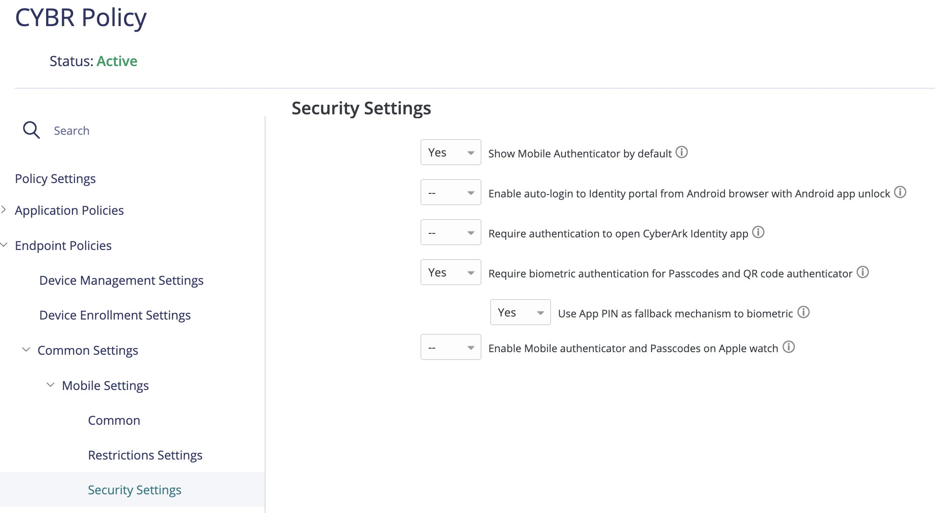
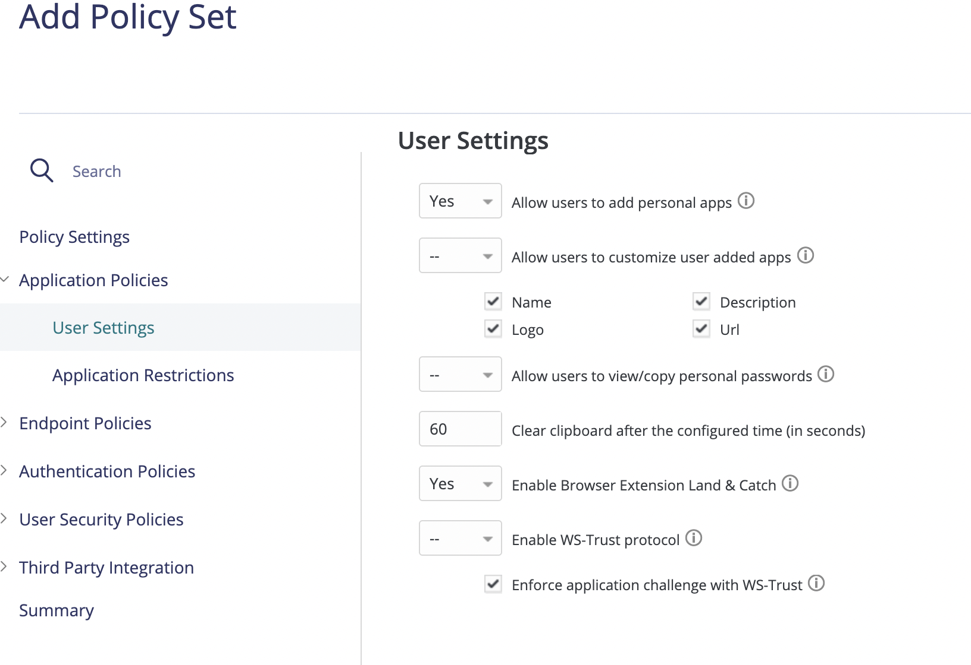
CyberArk Workforce Identity
Creating Roles and Policies
6. Go to Endpoint policies | Common Settings | Mobile Settings | Security Settings, enable the following options:
5. Go to Application Policies | User Settings and enable the following options:
Show Mobile Authenticator by Default: show the mobile authenticator in the Identity app (OATH OTP)
Require Biometric authentication for Passcodes and QR code authenticator: use biometric scanning to access passcodes or QR code scans for authentication.
Allow users to add personal apps: Allow the end user to add new applications to his/her Single Sign On (SSO) portal
Enable Browser Extension Land & Catch: Option to use the browser extension to capture username/password when authenticating to web pages

Slide 16
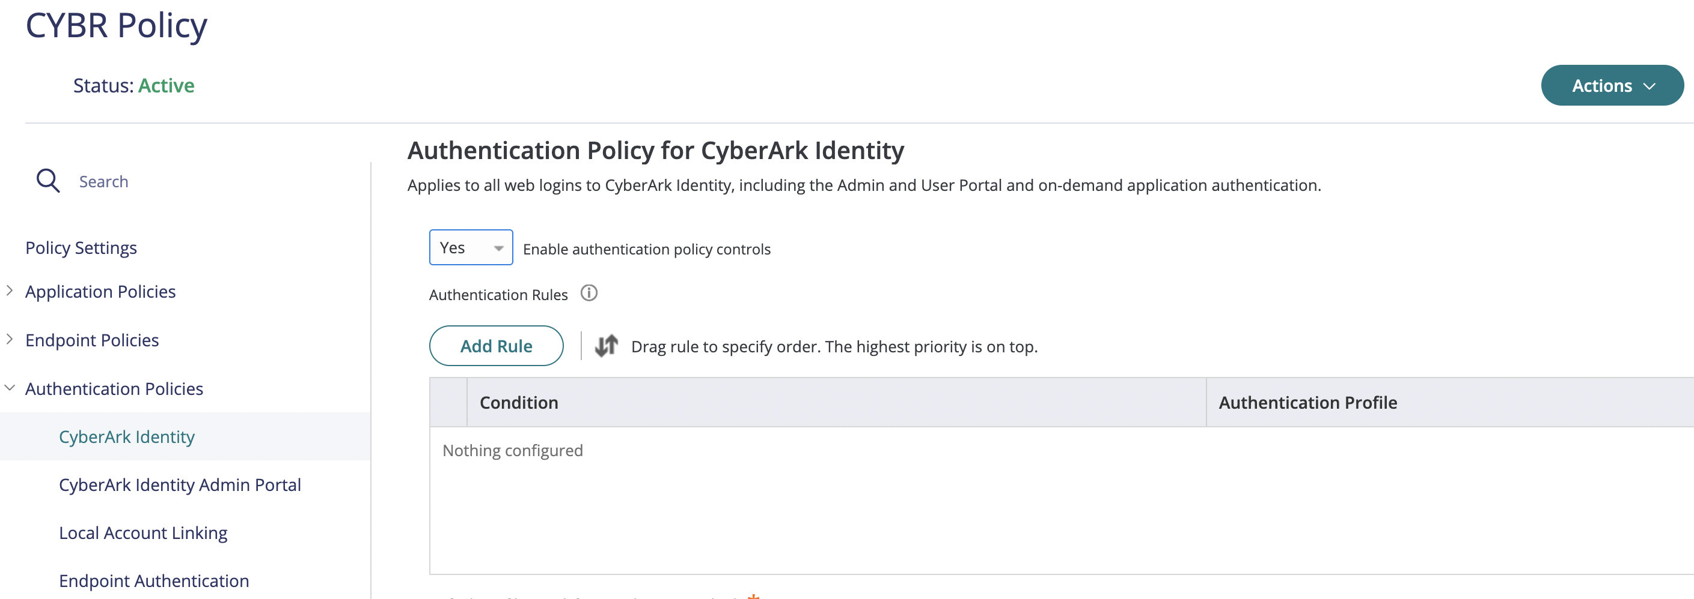
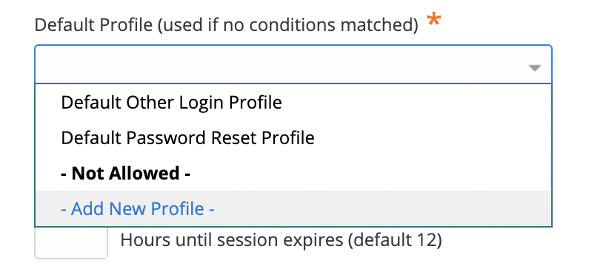
CyberArk Workforce Identity
Creating Roles and Policies
7. We will now secure user console access with MFA. Expand Authentication Policies | CyberArk Identity and enable Enable Authentication Policy Controls:
8. Expand Default Profile (used if no conditions matched), and select the Add New Profile option:

Slide 17

CyberArk Workforce Identity
Creating Roles and Policies
9. The authentication profile is where the required authentication mechanisms are defined, such as password, email confirmation code, mobile authenticator, etc. Define a name for the policy and enable the following options:
First challenge: Password
Second challenge: none (we will show the behavior when enabling second challenges later)

Slide 18


CyberArk Workforce Identity
Creating Roles and Policies
10. Now we will enable the possibility that our users can reset their password in case they forget it. Still in the policy properties, go to User Security Policies | Self Service, enable Enable Account Self Service Controls and create a new authentication profile:
11. Specify a name for the new policy, and enable only the following mechanisms in the first challenge column:

Slide 19


CyberArk Workforce Identity
Creating Roles and Policies
12. We will also allow our users to integrate with an OATH OTP (Identity Authenticator / Google Authenticator / MS Authenticator, etc). Go to User Security Policies | OATH OTP, and enable Allow OATH OTP Integration:
13. Expand Endpoint Policies | Device Enrollment Settings and enable Permit device Enrollment. Finally save (click on SAVE button) the policy that will apply to the users of the CYBR domain.

Slide 20



CyberArk Workforce Identity
CyberArk Identity Mobile App
1. Login to the User Portal with john@cybr.com (Cyberark1) – https://xxxxxxxx.id.cyberark.cloud
2. Go to the Devices menu:

Slide 21





CyberArk Workforce Identity
CyberArk Identity Mobile App
3. Download the CyberArk Identity app on your phone. Once installed, run the app and select the Enroll with QR option. Scan the QR code displayed in the User Portal.
4. Complete the registration process with user John (note that the username field is populated by default). Once the new device is registered, it will appear in the list:

Slide 22



CyberArk Workforce Identity
CyberArk Identity Mobile App
5. Go to Account | Authentication Factors and add a security question:
6. In the OATH OTP Client option, click Show QR Code and register your favorite OATH OTP client application (MS Authenticator, Google Authenticator, etc.)

Slide 23


CyberArk Workforce Identity
CyberArk Identity Mobile App
7. We will modify the authentication policy to add new mechanisms in the second challenge. In the Admin Portal, select Settings | Authentication | Authentication Profiles and edit the profile we created for users in the CYBR domain:
8. Add the following mechanisms in the Challenge 2 column:

Slide 24



CyberArk Workforce Identity
Multifactor Authentication
9. Authenticate to the User Portal with User john@cybr.com. Note that the first challenge is the password, and then we must select some mechanism as the second challenge. The list is updated depending on the mechanisms that we have available according to the registrations made in previous steps.
10. Try password and Mobile Authenticator. This will send a push to the mobile device Identity App:

Slide 25



CyberArk Workforce Identity
Multifactor Authentication
12. Now let's try a Passwordless authentication, authenticating with only QR code. Let's edit the authentication policy again in the Admin Portal, Settings | Authentication by selecting the policy for the CYBR domain. Enable QR Code under the Single Authentication Mechanism section:
11. Now try with password and OATH OTP code

Slide 26

CyberArk Workforce Identity
Multifactor Authentication
13. Now try to authenticate by simply scanning the QR code using the CyberArk Identity app:

Slide 27

CyberArk Workforce Identity
Application Management – SAML
The CyberArk Identity App Catalog contains thousands of integrations available. Administrators can provide SSO access to on-premises, cloud, and mobile applications. Once applications are configured, end users can authenticate to Identity and run any of your web applications without needing to re-enter their credentials. The following basic use cases show how to configure SAML, bookmark, and user/password applications.
1. Authenticate to the Admin Portal and navigate to the Apps & Widgets menu | Web Apps. Add a new Web App.

Slide 28



CyberArk Workforce Identity
Application Management - SAML
2. In the Add Web Apps window, on the Custom tab, add SAML:
3. In the Settings section, name the SAML app and add a custom logo image if you like.

Slide 29


CyberArk Workforce Identity
Application Management - SAML
4. In the Trust > Identity Provider Configuration > Metadata section, select the Download Metadata File option
5. In a new Chrome Browser tab, navigate to https://sptest.iamshowcase.com/index#start then select Instructions and then IDP initiated SSO

Slide 30

CyberArk Workforce Identity
Application Management - SAML
6. Click on Download Metadata. This will load our metadata in a new browser tab.
7. We need the URL of our metadata found in the address bar of the browser. Copy the URL into memory.

Slide 31


CyberArk Workforce Identity
Application Management - SAML
8. Go back to the Admin Portal, we will add the URL in the SAML Service Provider settings. In the properties of our SAML App, select the Trust menu in the Service Provider Configuration section, under Metadata, paste the URL from the previous step, and then click Load. This will popularize the XML portion of the metadata section:
9. On the Permissions menu, click Add and add John's account:

Slide 32


CyberArk Workforce Identity
Application Management - SAML
10. Authenticate with John in the User Portal and run the new SAML App. If the app does not appear, select the Reload Rights option by clicking on the menu for user John (upper right corner)
11. Clicking on the SAML App will open the RSA SAML test application, indicating successful federation for user John:

Slide 33


CyberArk Workforce Identity
Application Management - Bookmark
1. Use Bookmark-type applications when you want to provide a link to the URL of a web application. This link does not provide any authentication mechanism. In the Admin Portal, in the Apps & Widgets menu, add a new Web App of type Bookmark:
2. Add the URL: https://www.cyberark.com/resources/blog

Slide 34


CyberArk Workforce Identity
Application Management - Bookmark
3. In the Description menu, specify a name for the new app: CyberArk Blog. Change the logo if desired.
4. On the Permissions menu, add John's account:

Slide 35


CyberArk Workforce Identity
Application Management - Bookmark
5. Authenticate to the User Portal as John and run the newly created App:

Slide 36


CyberArk Workforce Identity
Application Management – User/Password App
1. In the User Portal, click the Add Apps button to add a new application from the CyberArk Catalog.
2. In the catalog, find and add the LinkedIn app:

Slide 37

CyberArk Workforce Identity
Application Management – User/Password App
3. In the application properties, specify the following options:
Add Tags: Social Media
Enable the Auto-Login at site option
Specify the username
Specify your password
Click in Save

Slide 38




CyberArk Workforce Identity
Application Management – User/Password App
4. Run the LinkedIn app from the SSO portal. This will prompt for installation of the browser extension, click Install, Download and then add it in Chrome. The browser extension is an addon required for SSO to certain web applications. The extension is required by any application that has a puzzle piece icon in the user portal.

Slide 39

CyberArk Workforce Identity
Application Management – Land & Catch
1. Apps can also be added to the User Portal using the Land&Catch feature of the browser extension. This feature detects when you enter credentials on a web page and then adds the site to your user portal. Land & Catch must be enabled by your system administrator and then enabled on your computer. In your browser, click on the Identity extension and verify that the Enable Land&Catch on this computer option is enabled.

Slide 40




CyberArk Workforce Identity
Application Management – Land & Catch
2. In your browser, enter the web application you want to add to the User Portal and authenticate with your own credentials. The browser extension will detect this action and will add the site to the User Portal. In this example, I'll use the Udemy app. Once the new application is added, try to login through the User Portal, notice that the credentials are injected automatically:

Slide 41



CyberArk Workforce Identity
Application Management – Infinite Apps
1. Infinite Apps is a browser extension feature that simplifies the creation of username/password applications that are not available in the catalog. Infinite Apps captures the username and password fields of the web application and adds the application to the Web Apps page of the Admin Portal, from where you can configure additional options, add authentication mechanisms and deploy the app to user portals and mobile devices. Infinite Apps is available for Firefox browsers only. On the CLIENT01 workstation, locate the Firefox installer and run it with the CYBR\Mike account:

Slide 42




CyberArk Workforce Identity
Application Management – Infinite Apps
2. In Firefox, authenticate to the Admin Portal and then enter the Downloads menu to download the browser extension:
3. Add the extension:

Slide 43


CyberArk Workforce Identity
Application Management – Infinite Apps
4. Authenticate to the browser extension:
5. In Firefox, go to a web application that you want to capture, in this example, I will use Github:

Slide 44


CyberArk Workforce Identity
Application Management – Infinite Apps
6. In the browser extension, click Settings – Advanced and then click the Capture button:
7. The fields will be captured automatically. In the wizard, specify that no additional values are required and leave the other options by default. Add the application to the Admin Portal.

Slide 45


CyberArk Workforce Identity
Application Management – Infinite Apps
8. In the Admin Portal, in the Apps & Widgets menu | Web Apps, note that the GitHub app was added, select it to edit its properties:
9. In the Permissions menu, add John:

Slide 46


CyberArk Workforce Identity
Application Management – Infinite Apps
10. In the Policy menu, we'll add an additional authentication mechanism to verify the user's identity every time they try to log in to the github portal. In the Default Profile section, select the Add New Profile option:
11. Specify GitHub as the name for the profile, and enable OATH OTP Client and Security Questions as authentication mechanisms in the first challenge:

Slide 47


CyberArk Workforce Identity
Application Management – Infinite Apps
12. Go to the Account Mapping menu, select the All Users share one name option, and add the username/password for the GitHub portal. Note that a single set of credentials could be shared by an entire development team. Finally click on Save:
13. In the User Portal, authenticated with John, go to the Github portal. Note that John does not have access to credentials, we have only published the app on his SSO portal.

Slide 48



CyberArk Workforce Identity
Application Management – Infinite Apps
14. Note that when you have configured MFA, an additional authentication method is requested, select OATH OTP Client and then specify the verification code obtained from your OATH client app. If the code is correct, the portal will open and the browser extension will inject the credentials into the GitHub portal:

Slide 49

CyberArk Workforce Identity
Application Management – Application Gateway
1. The Identity connector provides an Application Gateway functionality that allows end users to remotely access VPN-free web applications that are available on the organization's internal network. In this example, we'll add the IIS Web portal (https://comp01.cybr.com).

Slide 50


CyberArk Workforce Identity
Application Management – Application Gateway
2. In the Admin Portal, add a new Web App from the Apps & Widgets menu | Web Apps:
3. In the Add Web Apps window, on the Custom tab, add an app of type Bookmark:

Slide 51


CyberArk Workforce Identity
Application Management – Application Gateway
4. In the Application Settings menu, add the URL https://comp01.cybr.com:
5. On the Description menu, specify a new name for the app:

Slide 52



CyberArk Workforce Identity
Application Management – Application Gateway
6. On the Permissions menu, add John's account:
7. From the App Gateway menu, enable the Make this app available via the internet option, and select the Use this Idaptive generated external URL.... option. Then click on Test Connection:

Slide 53


CyberArk Workforce Identity
Application Management – Application Gateway
8. Authenticate to the User Portal as John and run the newly added application. If you get the error "This site cant be reached" wait a few minutes and try again. Note the URL generated by Identity.

Slide 54


CyberArk Workforce Identity
Endpoint Authentication
In this use case, we will install the CyberArk Identity Agent on the CLIENT01 workstation to demonstrate MFA authentication to the OS. We will test John's passwordless authentication with Mobile Authentication.
1. In the Admin Portal, in the Core Services menu | Policies, add a new policy for our Endpoints:
2. In the Policy Settings menu, name the policy (CYBR Endpoints):

Slide 55


CyberArk Workforce Identity
Endpoint Authentication
3. On the Authentication Policies menu | Endpoint Authentication, enable the Enable authentication policy controls option, and in the Default Profile section add a new profile:
4. Specify a name for the new profile (Endpoints Profile) and define the following authentication mechanisms. Finally save the new policy.

Slide 56


CyberArk Workforce Identity
Endpoint Authentication
5. Now we will generate a security code to enroll agents in our environment. Go to the Settings menu | Endpoints | Enrollment Codes and select the Add button:
6. In the Generate Bulk Enrollment Codes window, specify an expiration date and the maximum number of endpoints that can be enrolled with the code. Best security practices do NOT recommend to configure the code without an expiration date. COPY the code to a Notepad, you will not have access to the code later.

Slide 57


CyberArk Workforce Identity
8. Run the installer. On the Enter Enrollment parameters screen, specify the following options:
Tenant URL: url of your Identity Tenant
Enrollment Code: The enrollment code copied in previous steps.
Optional Parameters:
  -l “Usuarios CYBR” : The role that contains the users allowed to authenticate to the machine.
Endpoint Authentication
7. Go to the Admin Portal from the CLIENT01 workstation and in the Downloads menu, download the Windows Cloud Agent:

Slide 58





CyberArk Workforce Identity
Endpoint Authentication
9. Restart the CLIENT01 machine and attempt to authenticate with the user CYBR\John, following the authentication flow and selecting the Mobile Authenticator option as a second challenge.

Slide 59




CyberArk Workforce Identity
Endpoint Authentication
10. Now modify the authentication mechanism for the Endpoints and enable QR Code as the first and only challenge (Passwordless Authentication). Then restart the machine again and try to authenticate with the user CYBR\John.

Slide 60


CyberArk Workforce Identity
Secured Items
With CyberArk Workforce Password Management, we can allow our users to store personal confidential information on their User Portal, and also allow them to share those secure items with other users. CyberArk Identity stores:
- Passwords: Non-web application/service credentials
- Secured Notes: Credentials or secrets for use cases other than application access. For example: licenses, Access tokens, encryption keys, security questions, among others.
1. We will first hand over the right to share secure items to our users in the CYBR domain. For this, in the Admin Portal, go to the Core Services menu | Roles and edit the CYBR Users role:
2. Go to the Administrative Rights menu and add the shared credentials right, finally save your changes:

Slide 61


CyberArk Workforce Identity
Secured Items
1. Authenticate with User John in the User Portal and select the Secured Items menu. Then click Add Secured Notes
2. In the Secure Notes window, specify the requested values (Name, tag (for quick search), Notes, custom fields):

Slide 62


CyberArk Workforce Identity
Secured Items
3. On the Sharing tab, click Add and add the Identity admin user. We are going to share the note with him. Save your changes.
4. Now add a password with the Add Password button and fill in the corresponding options:

Slide 63

CyberArk Workforce Identity
Secured Items
5. On the Sharing tab, click Add and add the Identity admin user. We are going to share our password for the HR app with him. We will only allow you to view the password (not edit it) and only for a specified period of time:

Slide 64


CyberArk Workforce Identity
Secured Items
6. Do you remember that we added our personal Linkedin account as an SSO portal app? We need to give HR staff access to our account, so we will share access to the user. In the User Portal, in the Applications menu, edit the properties of the LinkedIn app and in the Sharing tab add the administrative user, without being able to see the password, and specify an access period of time:

Slide 65




CyberArk Workforce Identity
Secured Items
7. Now authenticate to the User Portal with the administrative user. Note that we have the LinkedIn application published in our profile. Review the properties of the application and then execute it. Finally enter the Secured Items menu and check if the shared items are listed.

